Slide 1
Simulation and Analysis of Electrochemical Systems
PhD Defense of
Michael S. Emanuel
in Applied Mathematics
Monday April 28, 2025
PhD Committee:
Chris H. Rycroft • Michael J. Aziz • Boris Kozinsky
michael.s.emanuel@gmail.com github.com/memanuel/PhD-Thesis linkedin.com/in/michael-emanuel
Notes:
Slide numbers check the font type

Slide 2
Overview

Slide 3
Four Scientific Works
Simulation
Analysis
1: Redox Flow Battery Twin
3: Acid- Base Generator
4: Quinone CO₂ Capture
2: State of Charge Mapping
Flow Batteries
Key
1 RFB Twin
2 SOC Map
3 ABG
4 QCC
Carbon Capture
3
Notes:
RFB - main research focus
CCS – serendipitous collaborations

Slide 4
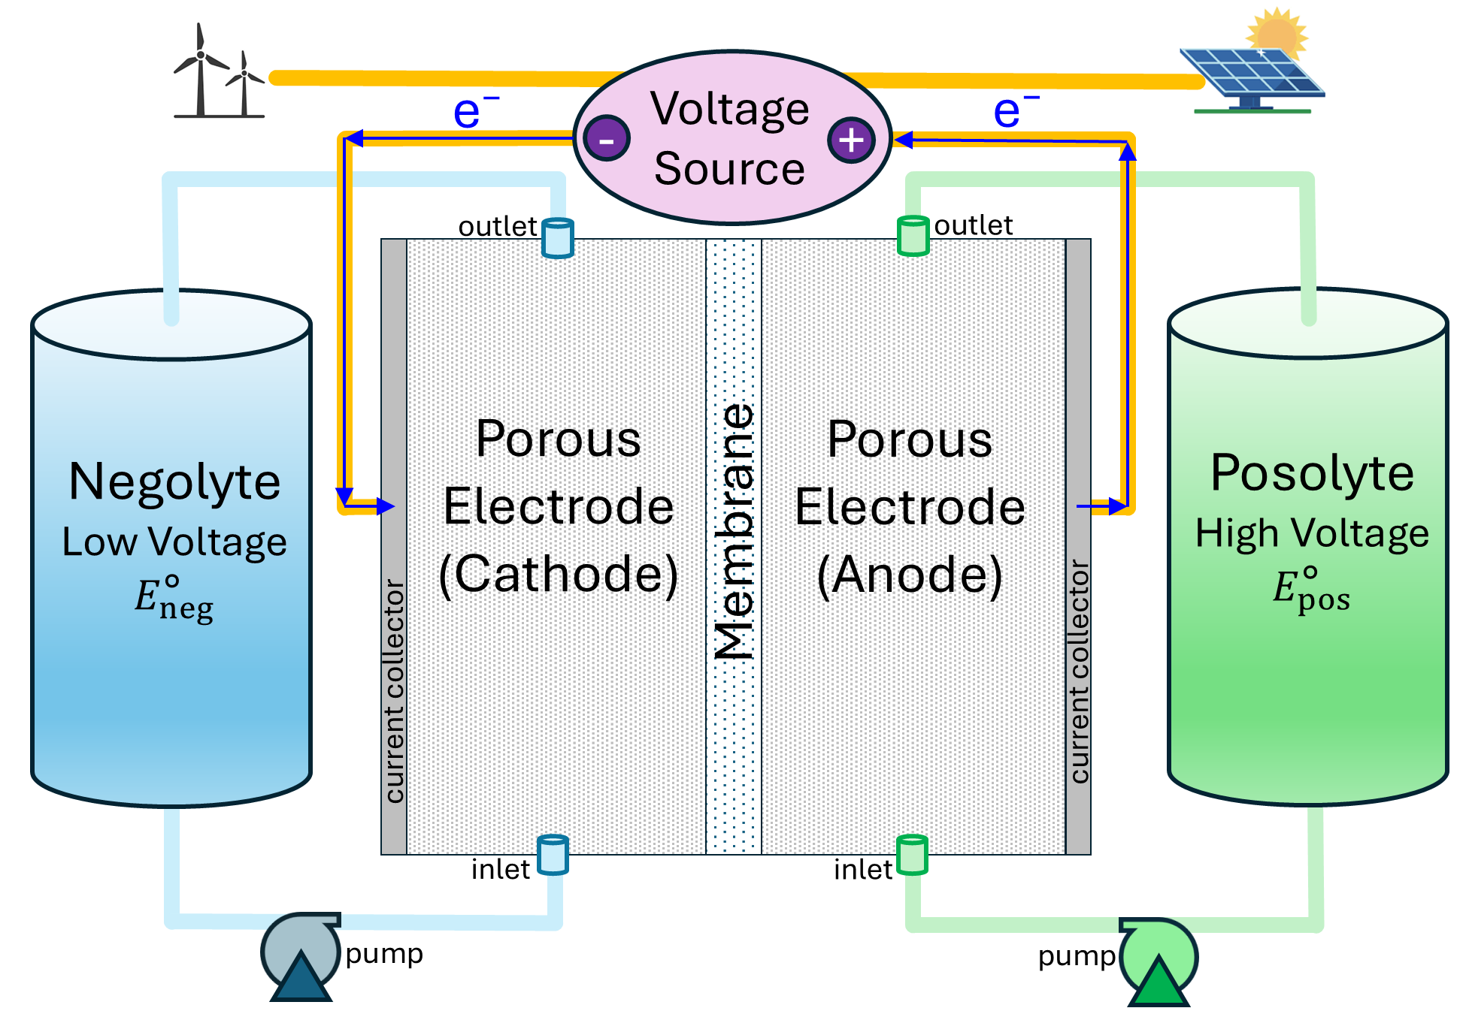
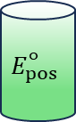
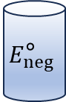
What is a Redox Flow Battery (RFB)?
1 RFB Twin
2 SOC Map
pH
Potential (V)
$$E_{pos}^{\text{∘}}$$
$$E_{neg}^{\text{∘}}$$
[HA] (mM)
Charge Movement
Charge battery by moving charge “uphill” to higher potential.
Redox Flow Battery being charged.
4
Notes:
The posolyte and negolyte redox reactions have a voltage difference, i.e. E○_{neg} < E○_{pos.} These are material properties.
The negolyte (Q) is reduced to H₂Q (reduction means gaining electrons). The posolyte (V⁴⁺) is oxidized to V⁵⁺ (oxidation means losing electrons)
Electrons flow from anode to cathode. Protons flow through the CEM

Slide 5
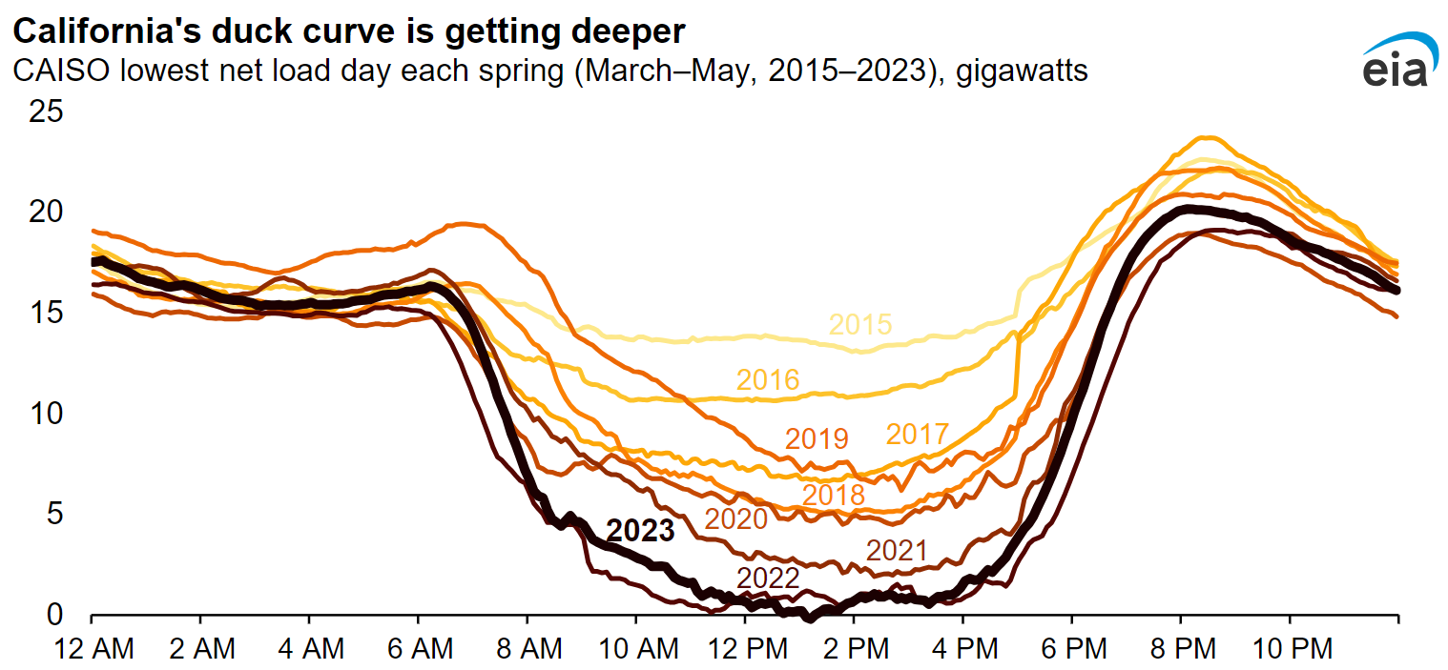
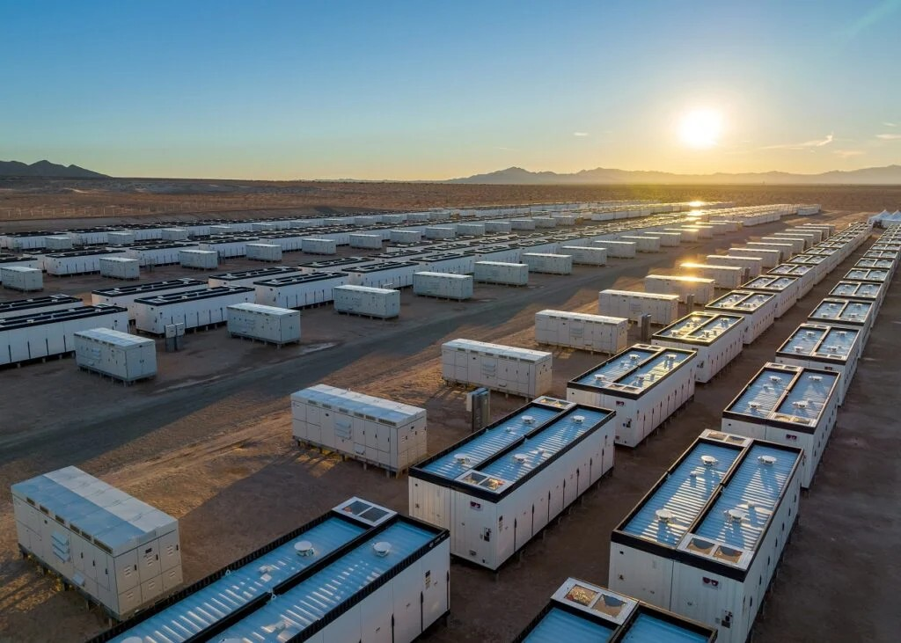
Why Redox Flow Batteries?
1 RFB Twin
2 SOC Map
Energy Information Administration.
Crimson Energy Storage in CA, 1400 MWh; largest BESS project to go live in the US in 2022 (Recurrent Energy)
Solar and wind are the cheapest, cleanest electricity today…
But they are intermittent: we need energy storage
Redox Flow Batteries (RFBs) are a promising energy storage technology
Decouples energy and power capacity; ideal for grid scale, long duration energy storage
5

Slide 6
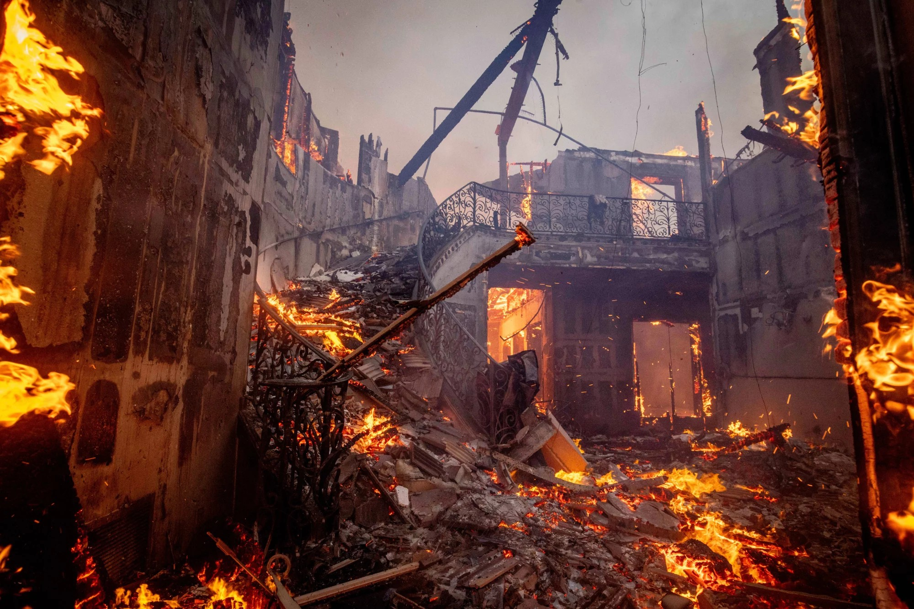
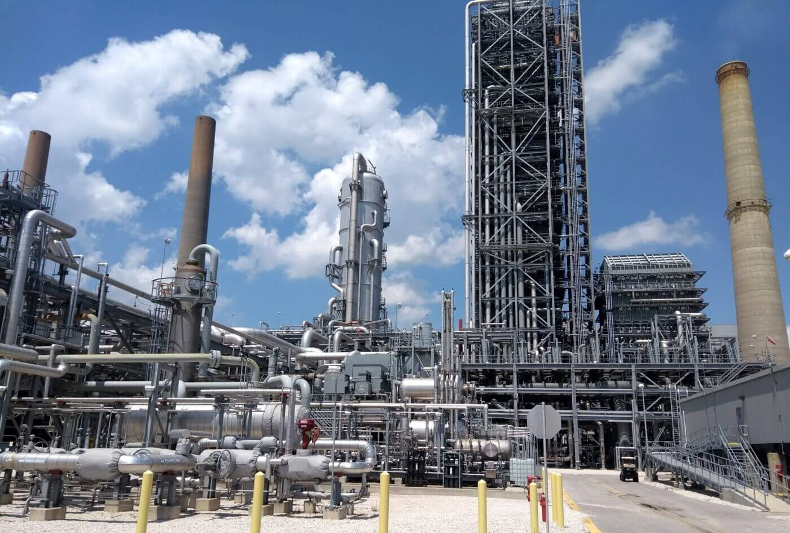
Why Carbon Capture & Storage (CCS)?
3 ABG
4 QCC
The Palisades Fire engulfs homes in the Pacific Palisades neighborhood of Los Angeles. (Ethan Swope/AP)
Petra Nova CCS facility at NRG WA Parish plant in TX. (Recurrent Energy)
Climate change is real
Carbon Capture & Storage (CCS) can be effective today for capturing flue gas...
And might allow future generations to repair Earth’s climate
6

Slide 7
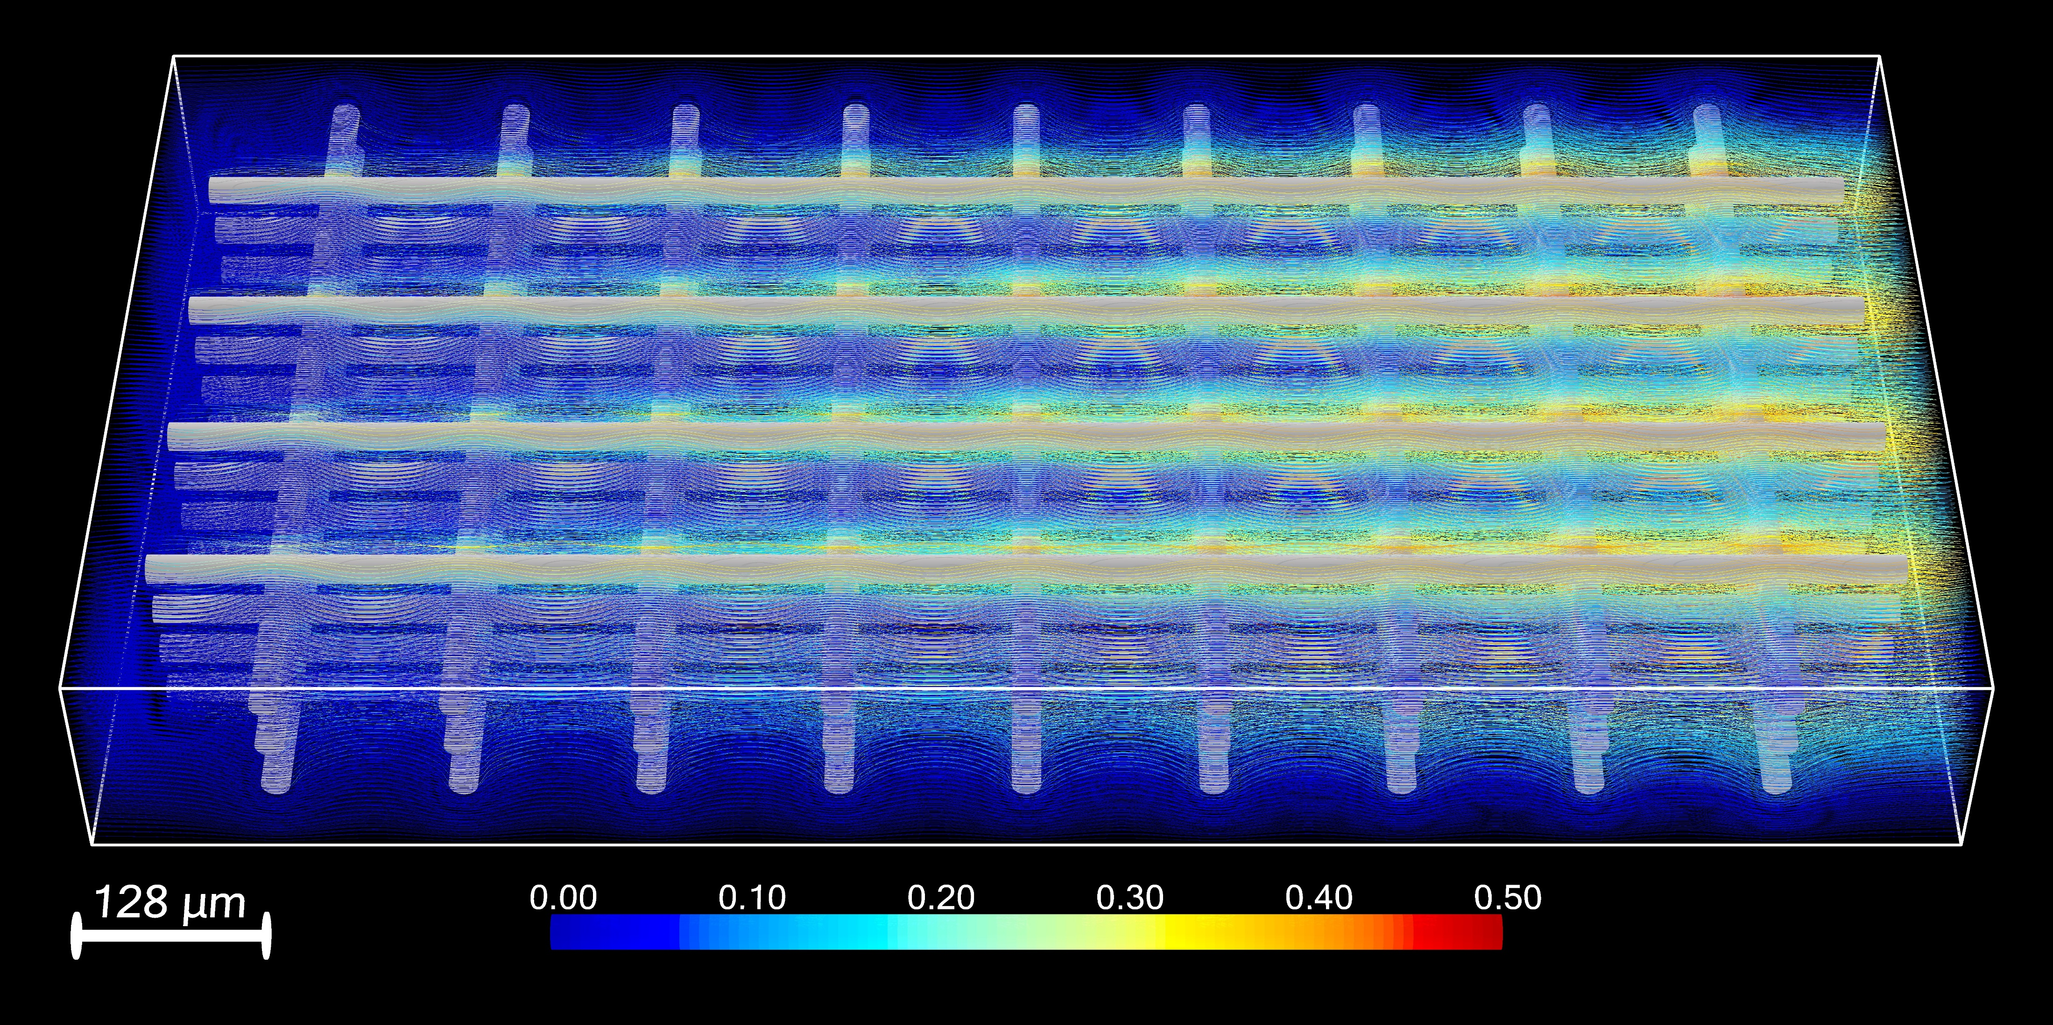
Digital Twin for Porous Electrodes in RFBs
1 RFB Twin
Direct numerical solution of governing PDEs
Phenomena—fluid flow, mass transport, electrochemical reaction
Unprecedented scale— 800M cells, 1.25 μm
SOC—state of charge (fraction of available energy stored locally)
SOC
Magnum Opus
M. S. Emanuel, C. H. Rycroft, Digital Twin for Porous Electrodes in Redox Flow Batteries. arXiv (planned submission to Physics of Fluids). DOI 10.48550/arXiv.2502.08034.
7
Notes:
Magnum opus – 4 years Direct numerical solutions of the governing equations.
Incompressible flow: Navier-Stokes equation. Mass transport: Nernst-Planck equation. Chemical kinetics: Butler-Volmer equation. Electrostatics: Poisson equation

Slide 8
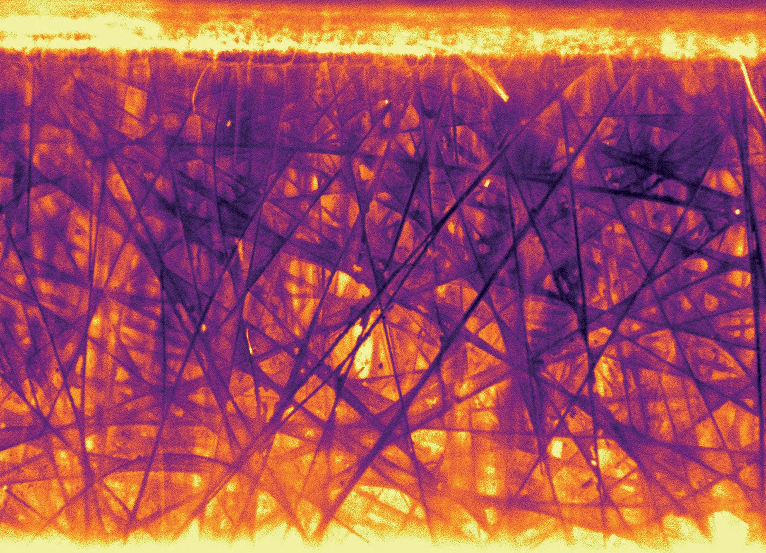
Calculating State of Charge from Image Data
2 SOC Map
100
pH
Commercial porous electrode was imaged
Reduced species is brighter than oxidized species
But SOC calculations failed: shadows, nonlinear response, misalignment
Model of light production and optical transfer
50
[HA] (mM)
Salvaging a manuscript.
0
200 μm
SOC (% max)
D. Xi, Y. Zheng, M. S. Emanuel, P. Zhao, M. J. Aziz, Electrochemical Acid-Base Generators for Decoupled Carbon Management. Energy & Environmental Science.
8
Notes:
Our manuscript was languishing unpublished and performed an iterative calibration
The results were good!

Slide 9
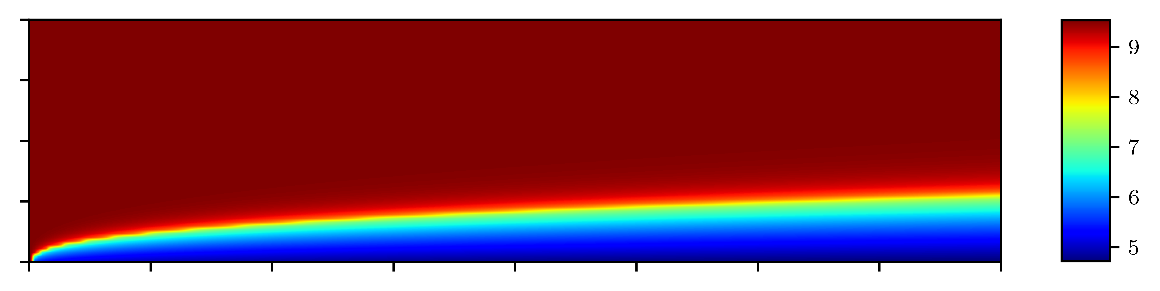
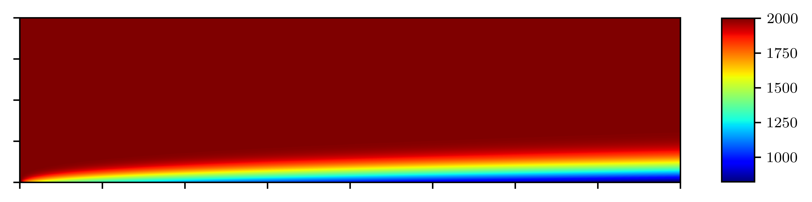
Simulating an Acid-Base Generator
3 ABG
pH
Simulation of Acid-Base Generator (Dawei Xi)
Mass transport in 2D
Crossover—problem where species crosses into the “wrong” chamber
Computational answer to an engineering question about crossover
NaA flows to right
H⁺
H⁺
[Na⁺] (mM)
L_{y} = 0.10 cm
Electric Field
Na⁺
L_{x} = 11.18 cm
“COMSOL doesn’t work!”
D. Xi, Y. Zheng, M. S. Emanuel, P. Zhao, M. J. Aziz, Electrochemical Acid-Base Generators for Decoupled Carbon Management. Energy & Environmental Science. DOI 10.1039/D4EE05109B.
9
Notes:
Sodium acetate flows left to right. Electric field points up; this pushes sodium ions up to generate strong base.
Simulating mass transport with Nernst-Planck Eq. Called in after “COMSOL doesn’t work”
A = acetate (CH3COO-).

Slide 10
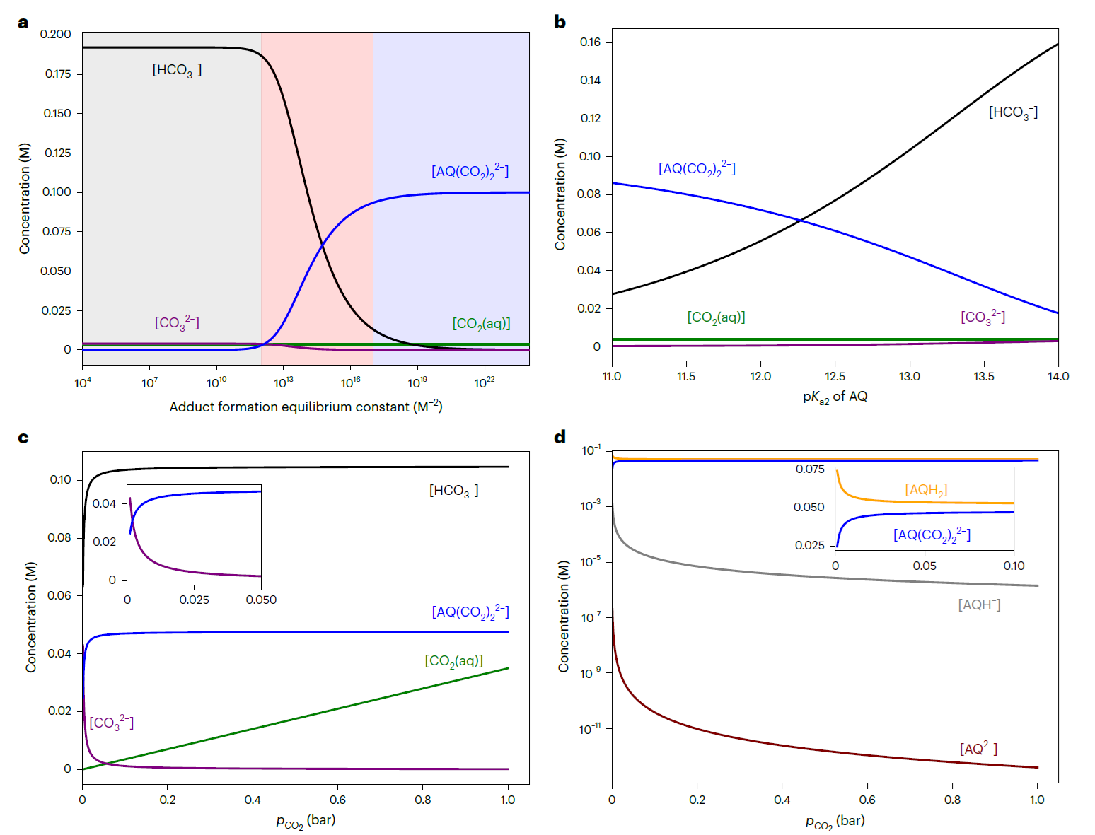
Thermodynamic Analysis of a Quinone CCS
4 QCC
Quinone based CCS system (Kiana Amini)
Two capture mechanisms, pH swing and nucleophilic swing
“Simple” thermodynamic calculation can explain their relative importance
Solved equilibrium simple numerical techniques
Conclusion: three regimes varying by dominant capture mechanisms
pH
[HA] (mM)
“I have a problem…”
K. Amini, T. Cochard, Y. Jing, J. D. Sosa, D. Xi, M. Alberts, M. S. Emanuel, E. F. Kerr, R. G. Gordon, M. J. Aziz, In Situ Techniques for Aqueous
Quinone-Mediated Electrochemical Carbon Capture and Release. Nature Chemical Engineering. DOI 10.1038/s44286-024-00153-y
10
Notes:
Kiana: “I need help” with a system of equations—scipy optimizer isn’t working.
Solved in two days using a few simple tricks.
Resulting analysis was Figure 1 of published work

Slide 11
1. Digital Twin for Porous Electrodes in Redox Flow Batteries
1 RFB Twin

Slide 12
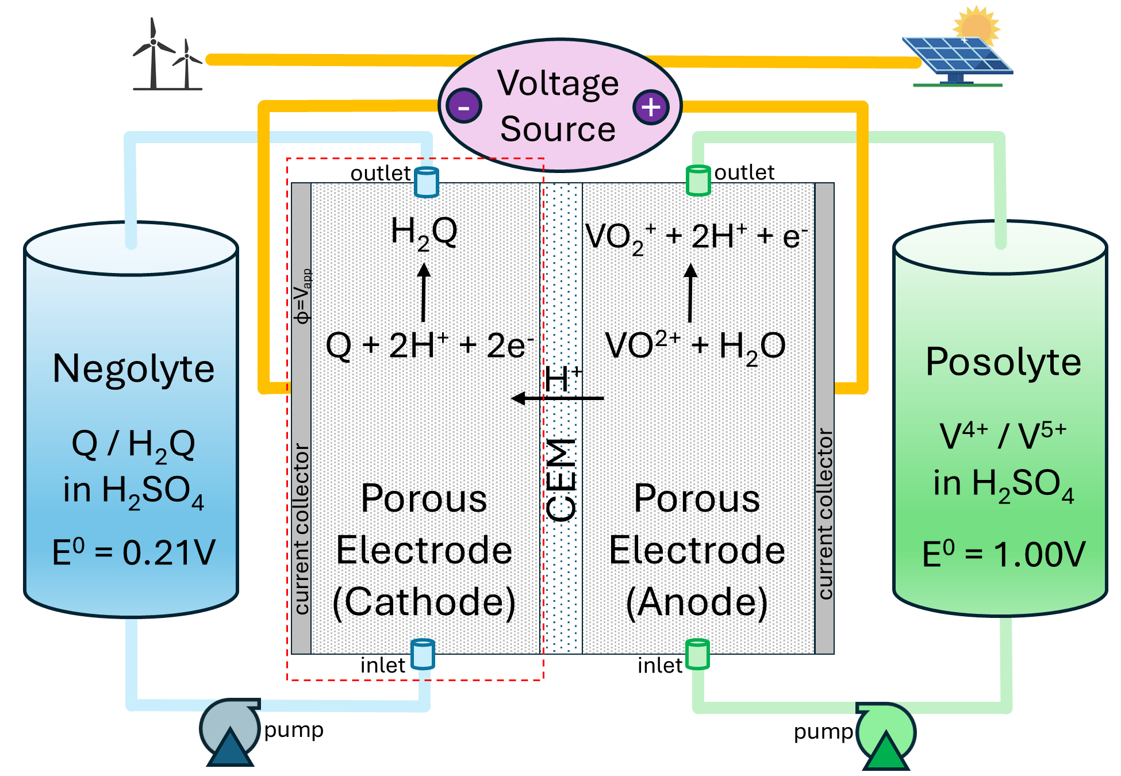
Simulation Overview of Redox Flow Battery
pH
Simulated the porous electrode at the cathode (dashed red rectangle) while the battery is charged.
Membrane is at a constant voltage
Current collector held at a lower, applied reducing voltage, V_{ar}
Porous electrode also at V_{ar}
This drives reduction of Q to H₂Q
H⁺ crosses CEM, balancing charge
[HA] (mM)
Digital Twin for Porous Electrodes in Redox Flow Batteries.
12
Notes:
The posolyte and negolyte redox reactions have a voltage difference, i.e. E○_{neg} < E○_{pos}
The negolyte (Q) is reduced to H₂Q (reduction means gaining electrons)
The posolyte (V⁴⁺) is oxidized to V⁵⁺ (oxidation means losing electrons)
Electrons flow from anode to cathode
Protons flow through the CEM

Slide 13
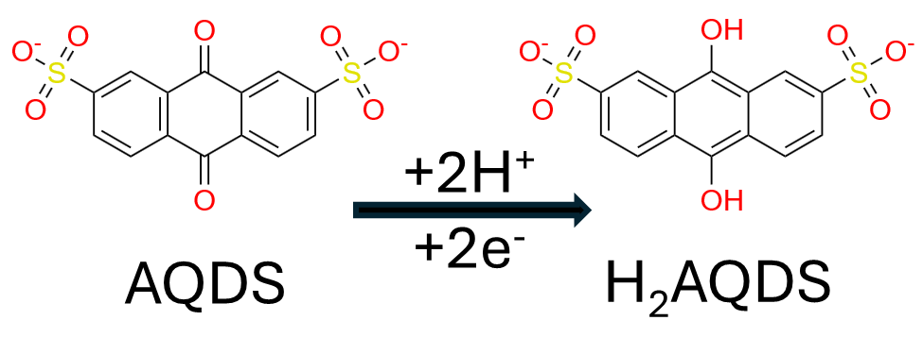
What is AQDS (Anthraquinone Disulfonate)?
pH
Aqueous organic: dissolves in water, carbon based
Redox active: undergoes a reversible electrochemical reaction…
Desirable properties:
Fast kinetics
High solubility in water
Long lifetime
Earth abundant elements
Discovered by Aziz-Gordon collaboration [2014]
[HA] (mM)
Digital Twin for Porous Electrodes in Redox Flow Batteries
13
Notes:
Coupled two electron, two proton transfer (PCET)

Slide 14
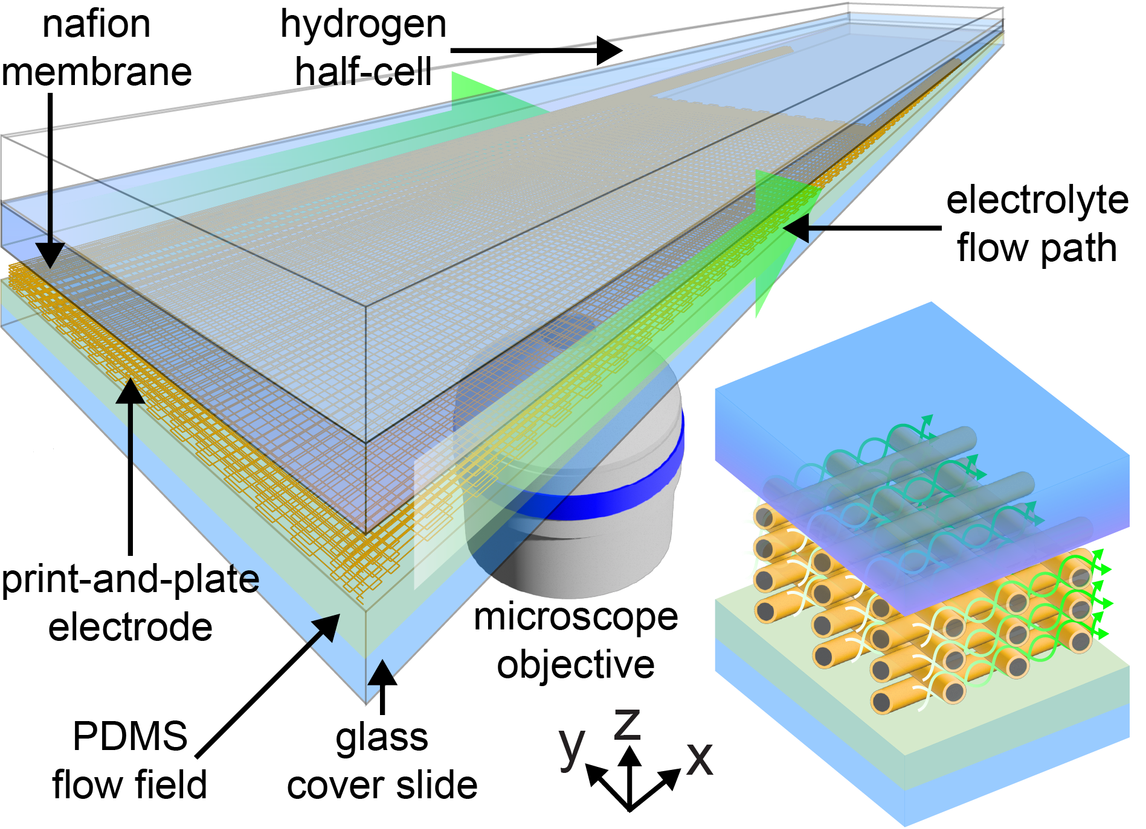
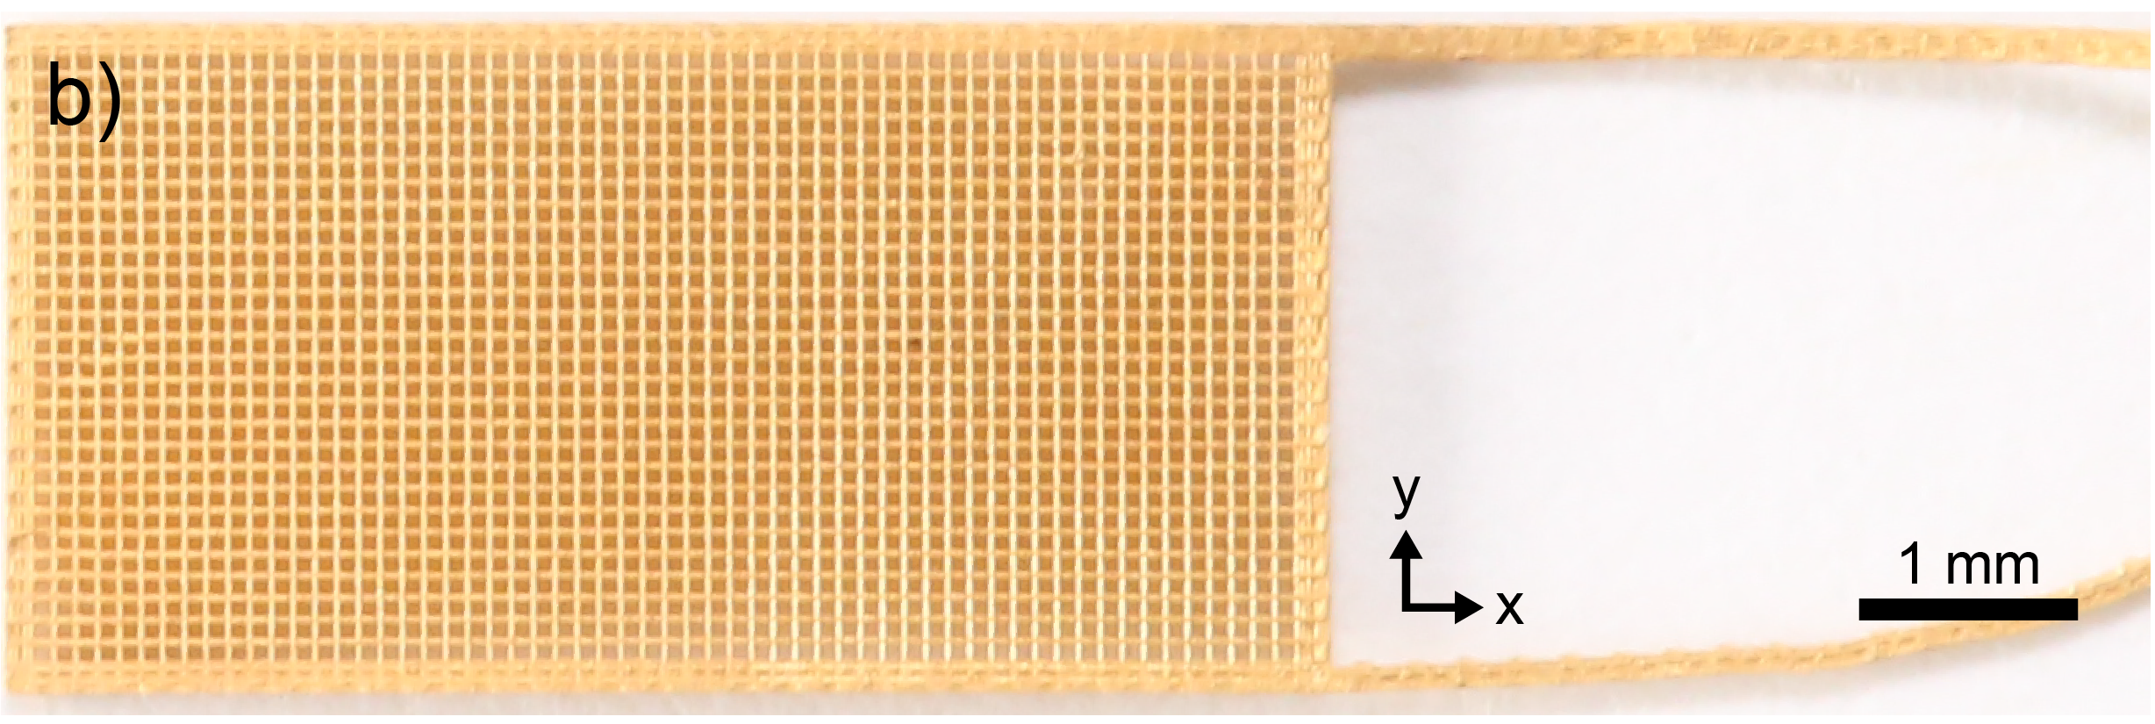
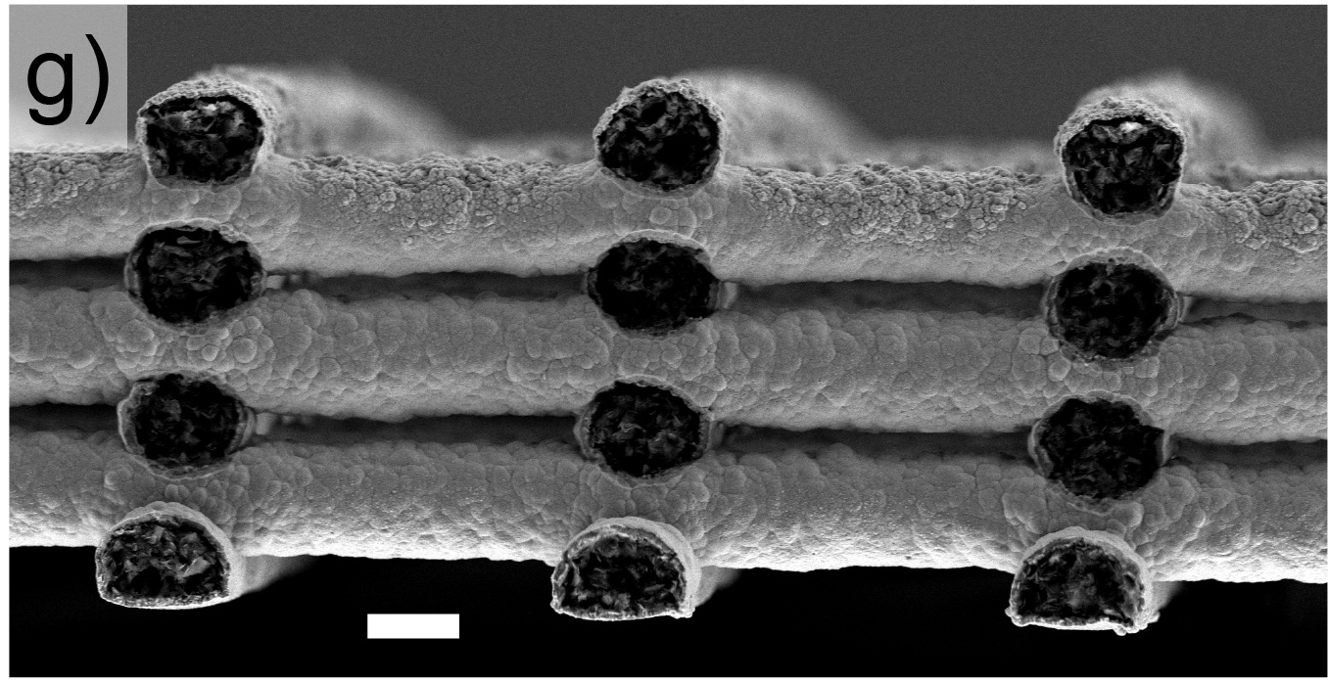
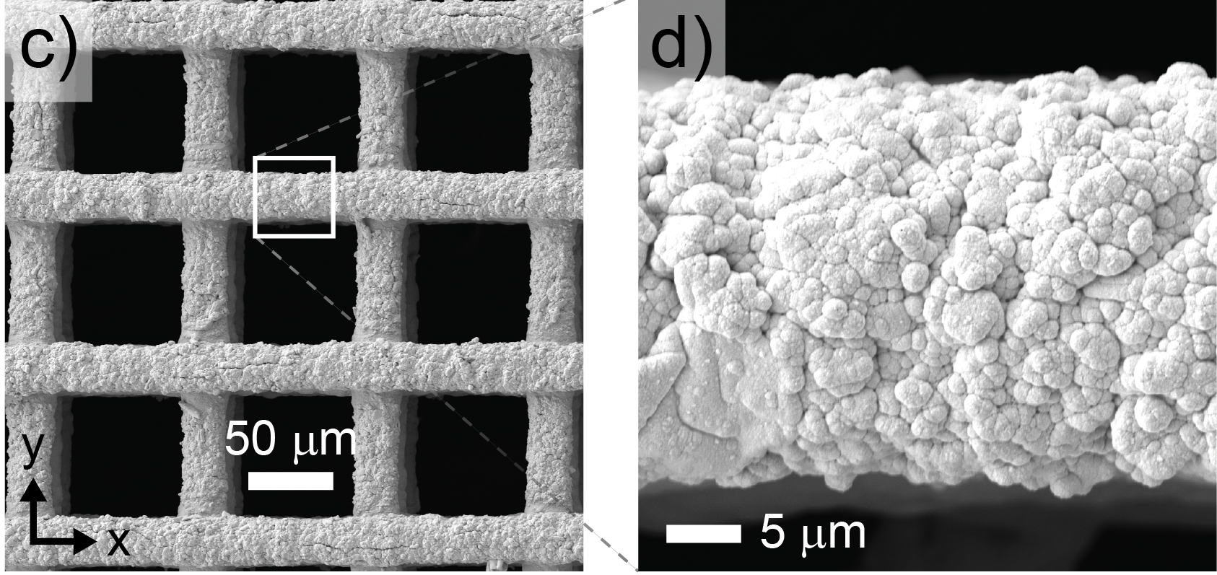
Experiment with a 3D Printed Electrode
Architected electrodes were 3D printed and electroplated (Ni, Au)
Known, regular “logpile” geometry
Commercial electrodes—tangle of fibers
Imaged in 3D using confocal microscopy
Gold wires at a reducing voltage V_{ar} < 0
Task: simulate in 3D at a sub-fiber scale
D. M. Barber, S. Edgar, M. S. Emanuel, M. D. Nelwood, B. Y. Ahn, B. Román-Manso, T. Cochard, J. Platero, K. Amini, C. H. Rycroft, S. Rubinstein, M. J. Aziz, J. Lewis, Print-and-Plate Architected Electrodes for Electrochemical Transformations Under Flow. Advanced Functional Materials. DOI 10.1002/adfm.202419748.
14
Notes:
Schematic of experiment. Fluid flows left to right (x-axis). Fiber diameter ≈ 35 μm Membrane at z=0 and has voltage φ = 0.
Comment on interplay between experiment and simulation – complement each other.

Slide 15
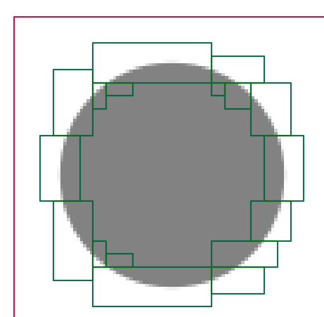
Loosely Coupled Problems & Discretization
Fluid Flow
Navier-Stokes equation
Incompressibility condition
Chorin Projection Method
Electrochemistry
Nernst-Planck equation (transport)
Butler-Volmer equation (kinetics)
Fixed-Point Iteration
Coupled
Decoupled
Numerical Methods
AMReX Library
Cut cells with implicit boundary
Algebraic Multigrid solvers (HYPRE)
Highly scalable MPI program
Steady State
Main concern for RFBs
Faster to simulate than full dynamics
Example of cut cells and mesh refinement in 2D
15

Slide 16
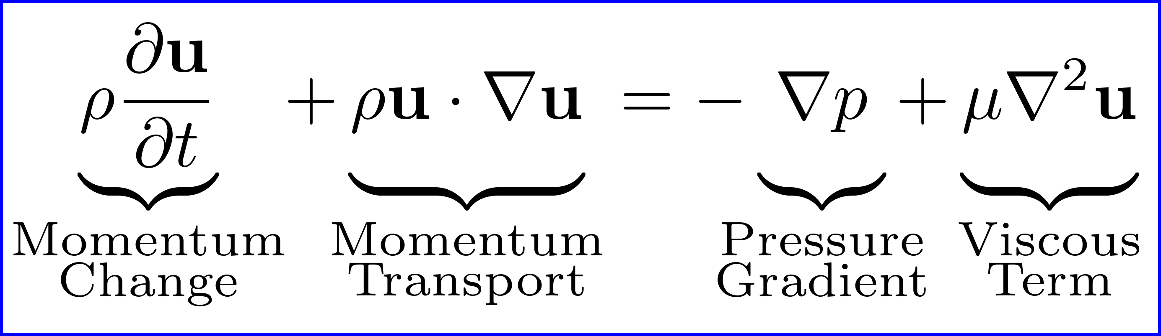
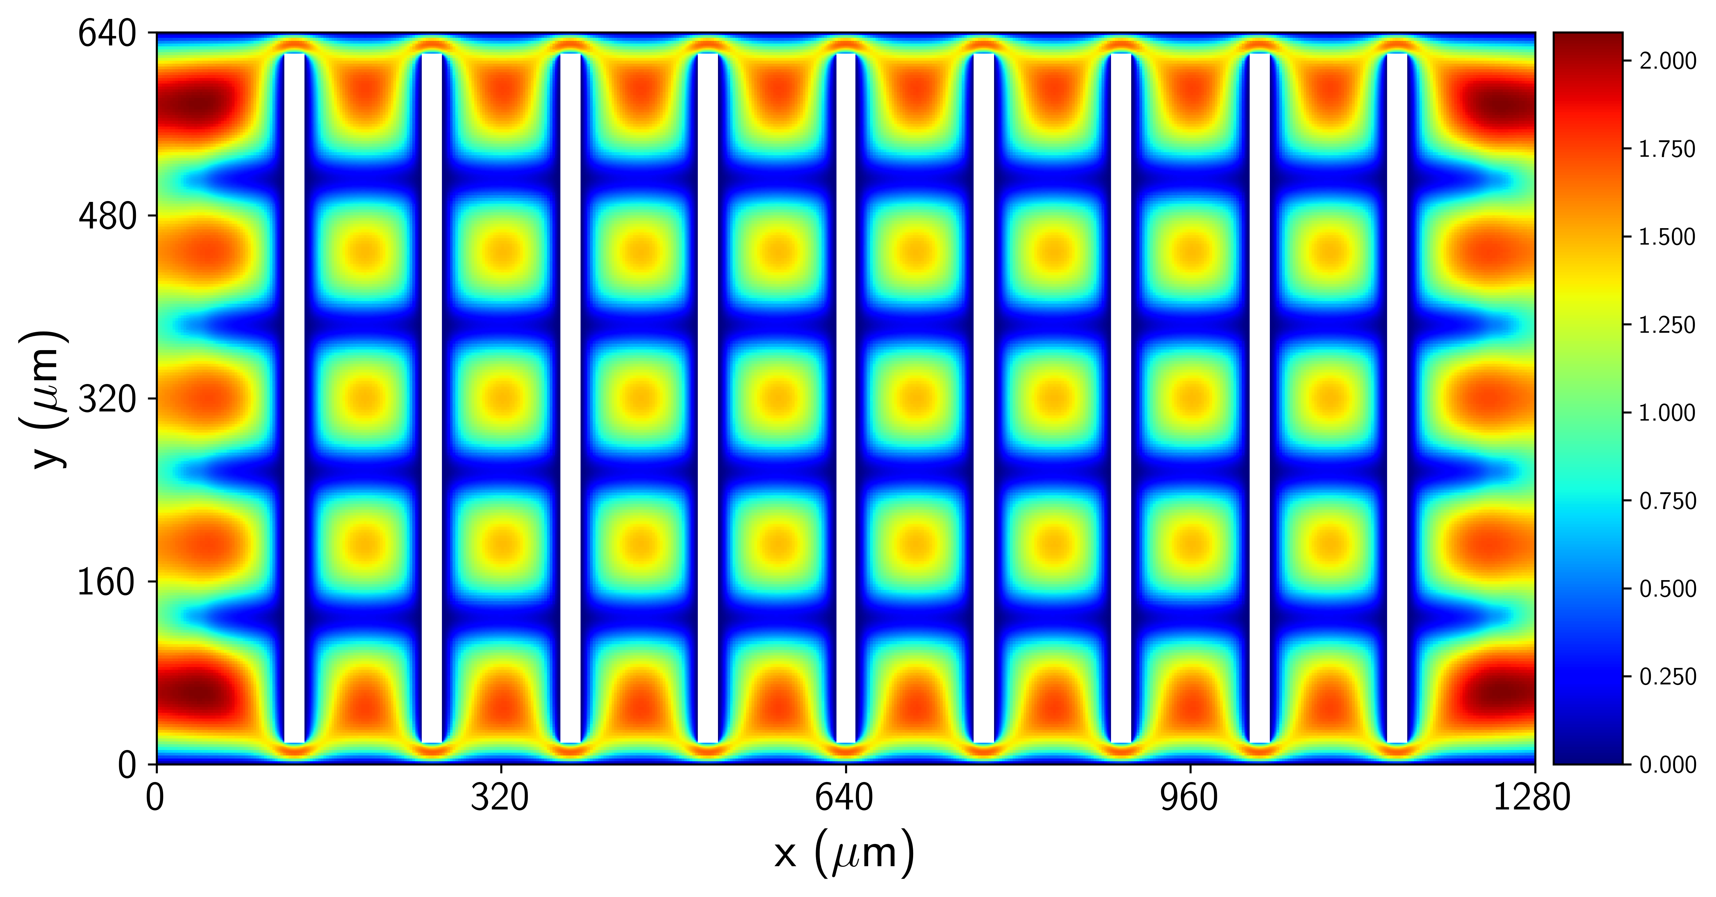
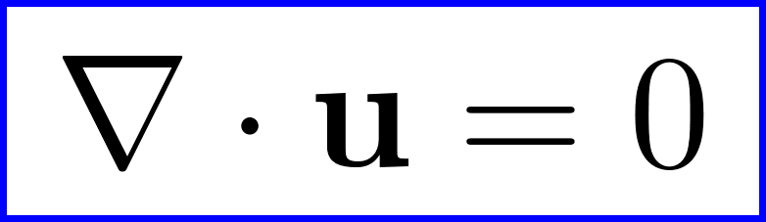
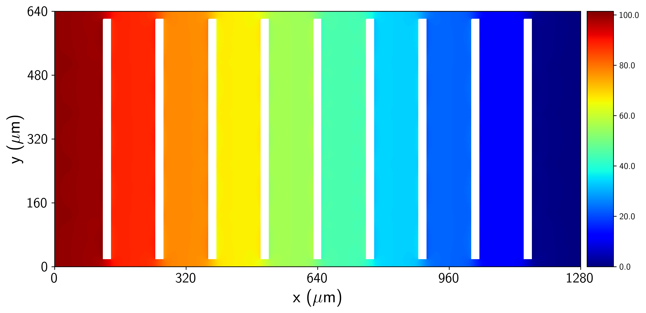
Fluid Flow: Navier-Stokes Equation
Navier Stokes equation
2D cross section of fluid speed
Speed (cm/s)
Incompressibility condition
2D cross section of fluid pressure
SOC
Term | Concept | Units
ρ | Fluid density (constant scalar) | kg·m⁻³
μ | Dynamic viscosity (constant scalar) | Pa·s
u | Fluid velocity (vector field) | m·s⁻¹
p | Fluid pressure (scalar field) | Pa
16

Slide 17
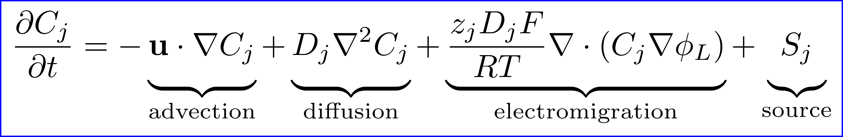
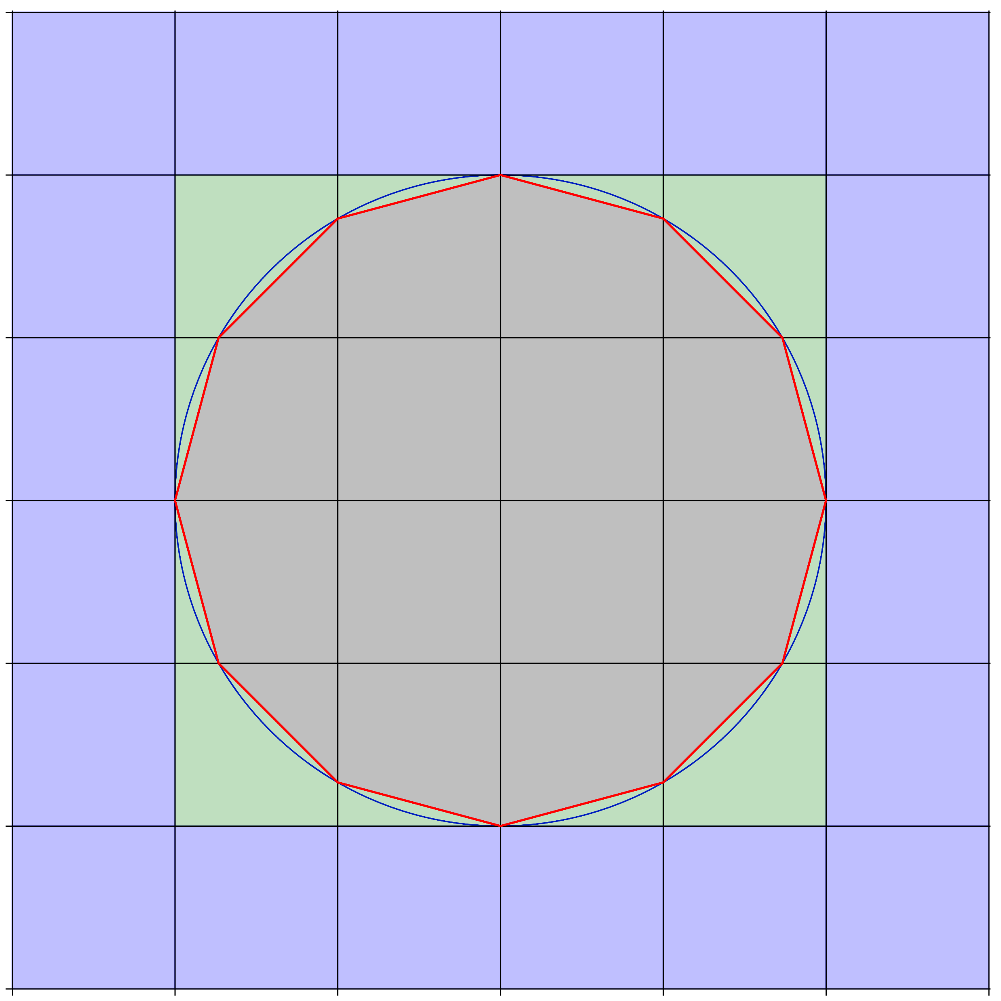
Mass Transport: Nernst-Planck Equation
Term | Concept | Units
u | Steady state fluid velocity | m·s⁻¹
D_{j} | Diffusivity of species j | m²·s⁻¹
z_{j} | Charge number of species j | 1
C_{j} | Concentration of species j | mol·m⁻³ = mM
S_{j} | Chemical source term of species j | mol·m⁻³·s⁻¹
φ_{L} | Electrical potential in liquid electrolyte | V = Joule·Coul⁻¹
F | Faraday’s constant | Coul·mol⁻¹
R | Ideal gas constant | Joule·mol⁻¹·K⁻¹
T | Absolute temperature (Kelvin) | K
Regular cells (all fluid)
Cut Cell
Covered Cells (all solid)
17

Slide 18
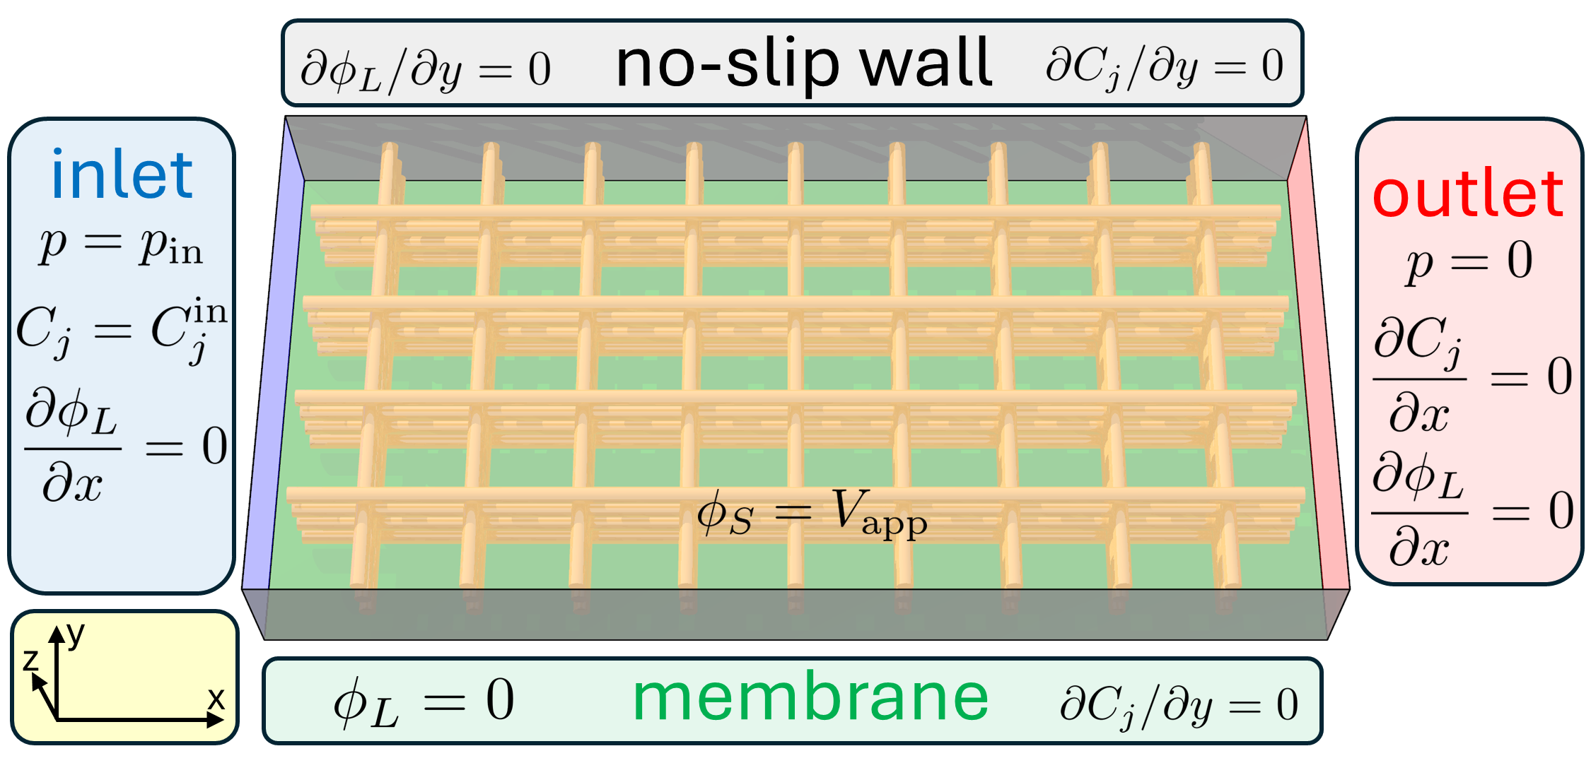
Boundary Conditions & Simulation Overview
Applied pressure and fixed concentrations at inlet
Pressure drop drives the flow left to right
No-Slip condition at bottom, top, left, right walls
Membrane at bottom: no slip and zero potential, φ_{L} = 0
Wires: no slip, applied reducing potential φ_{S} < 0
Digital Twin for Porous Electrodes in Redox Flow Batteries.
18
Notes:
Lower pressure at outlet
Wire Surface: Electrochemical reaction, conversion from oxidized to reduced creates a flux

Slide 19
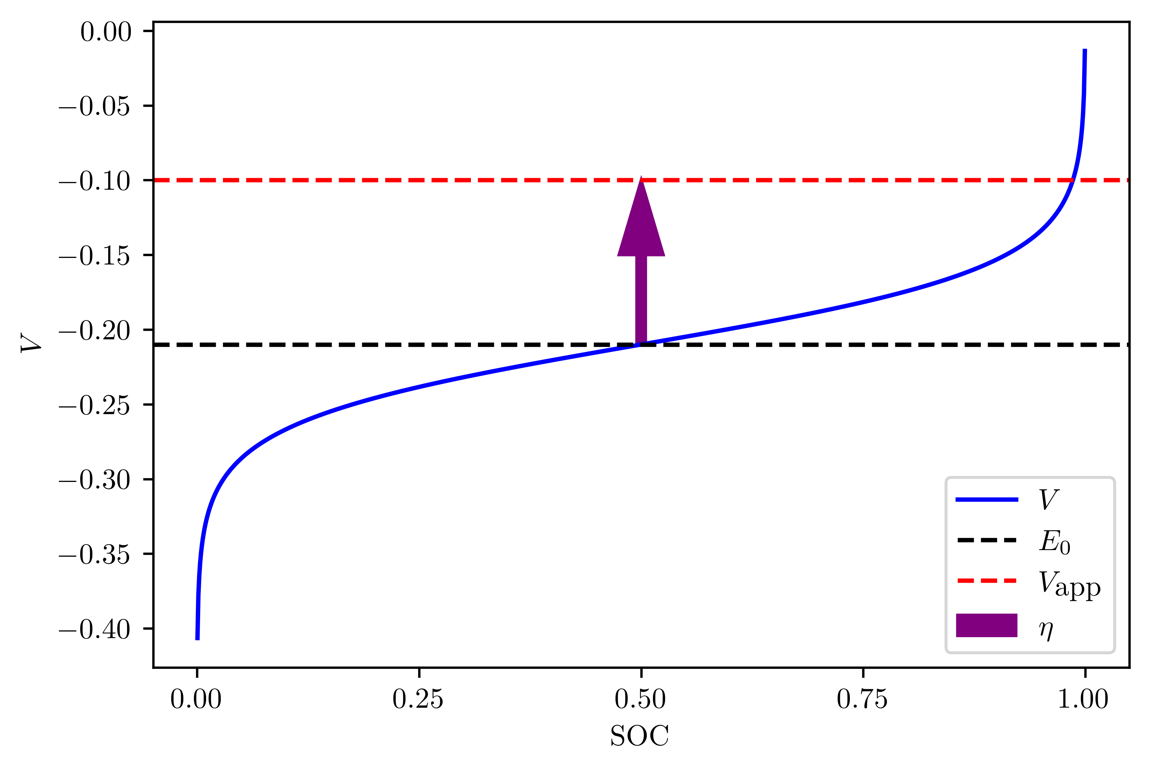
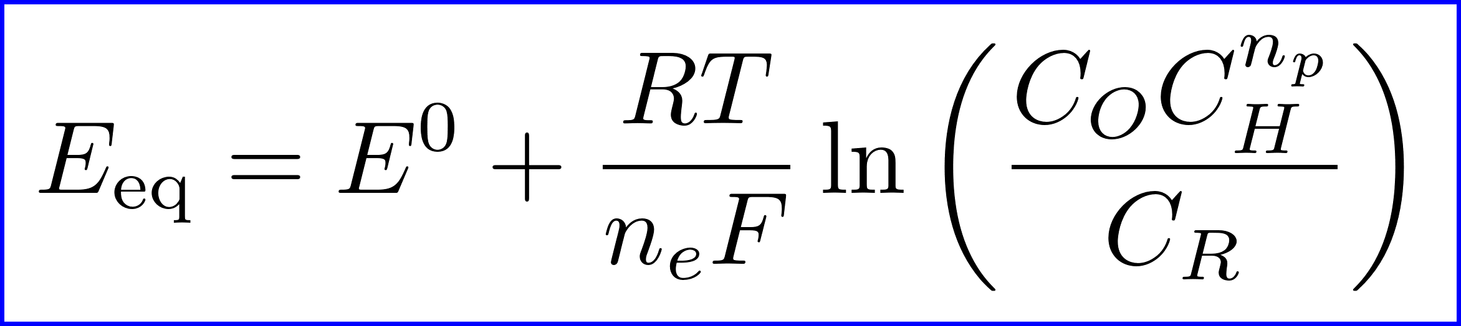
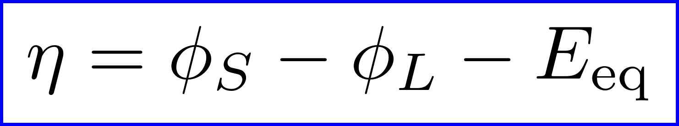
Nernst Equation and Overpotential
Reducing Voltage vs. State of Charge
The Nernst equation gives equilibrium potential E_{eq} vs. reference potential E⁰ as concentration varies
η is called the overpotential
O: oxidized species R: educed species
Sign convention: V_{ar} is “reducing voltage.”
A larger reducing voltage drives reduction (charging)
19
Notes:
As SOC increases, it’s harder to add charge.
The vertical gap is the overpotential η.

Slide 20
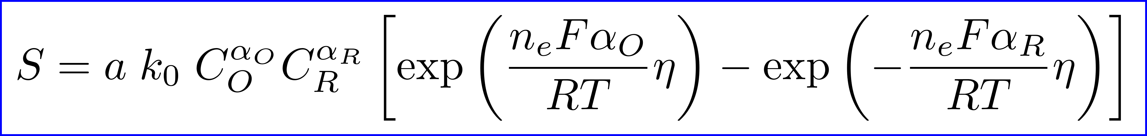
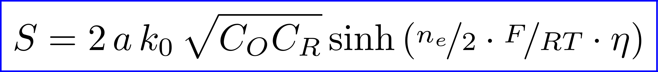
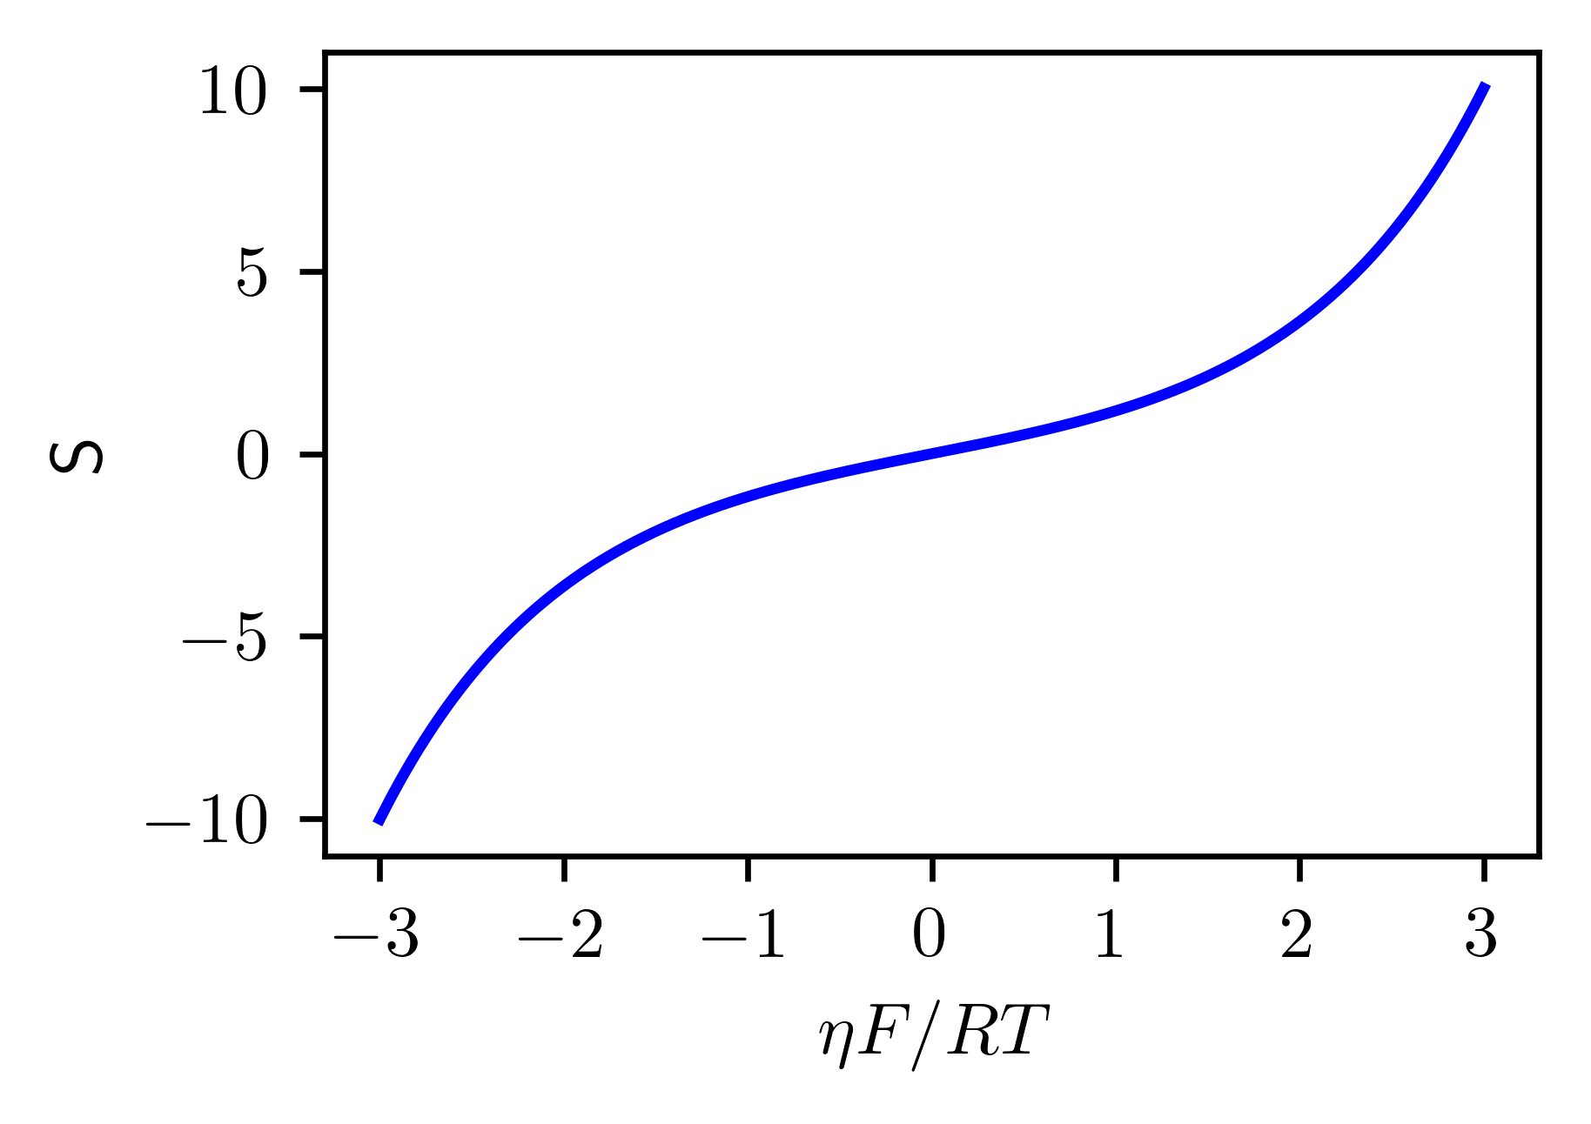
Reaction Kinetics: Butler-Volmer Equation
Typically, we assume a perfectly reversible reaction, i.e. α_{O} = α_{R} = 0.5, so
Term | Concept | Units
O | Generic oxidized species, e.g. quinone Q | —
R | Generic reduced species, e.g hydroquinone H₂Q | —
S | Chemical source term; concentration change rate | mol·m⁻³·s⁻¹
a | Specific area of solid-liquid interface | m⁻¹ = m²/m³
k₀ | Reaction rate constant | m·s⁻¹
α_{j} | Charge transfer coefficient of species j | 1
η | Activation overpotential | V
Stylized Source vs. Overpotential
20
Notes:
Exchange current – how fast does reaction happen forward and backward at the same speed. Analogy: restaurant with people entering and exiting.

Slide 21
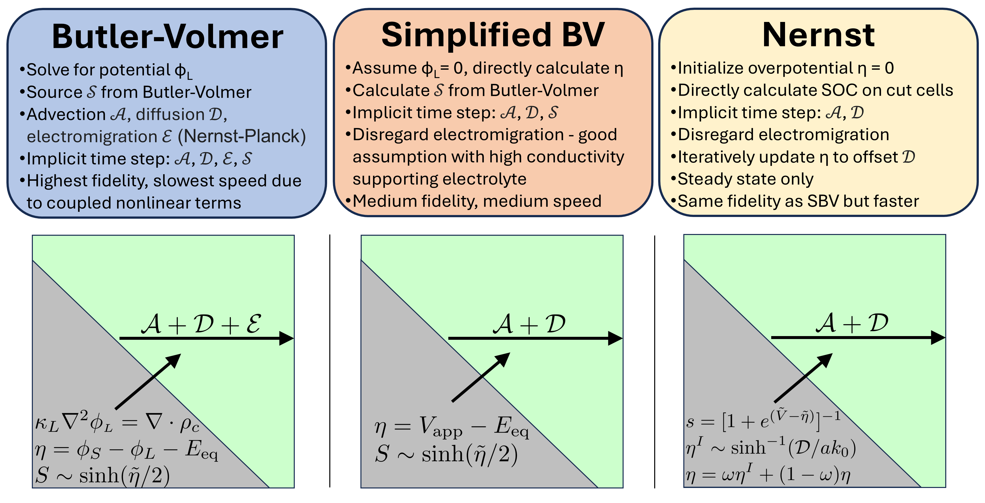
Model Overview: Three Levels of Fidelity
21

Slide 22
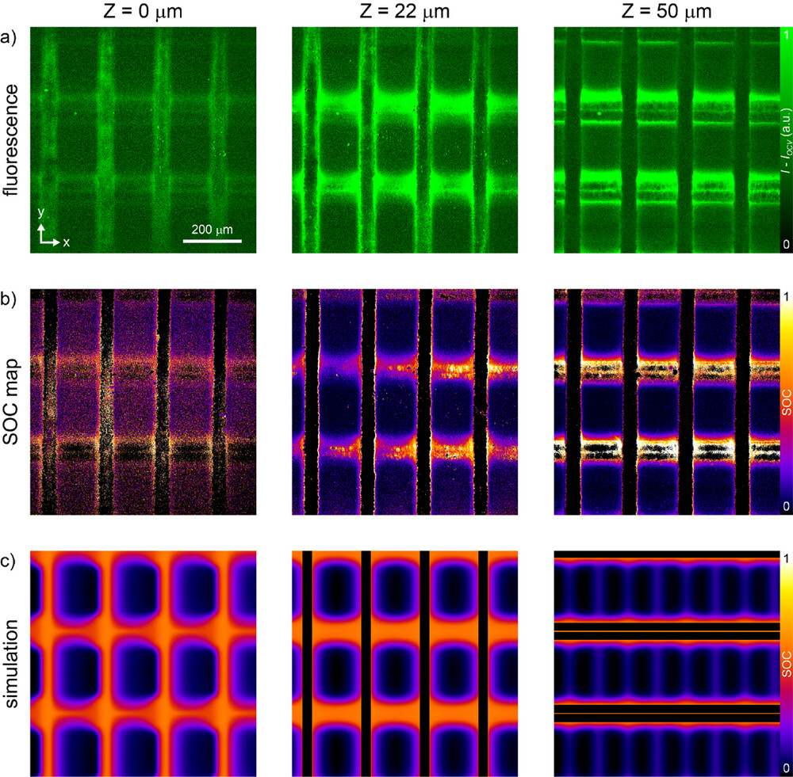
Good Agreement with Experiments
a) Fluorescence data of logpile electrode at three slices; background is subtracted
b) Calibrated experimental SOC
c) Corresponding simulated SOC
Note good qualitative agreement with build-up of high SOC above vertical and horizontal wires, and in convective tails coming off them
Print-and-Plate Architected Electrodes for Electrochemical Transformations Under Flow.
22

Slide 23
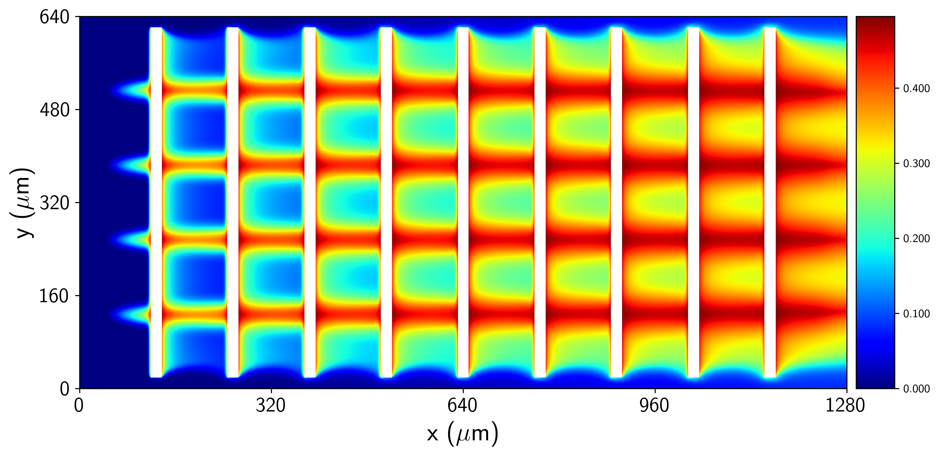
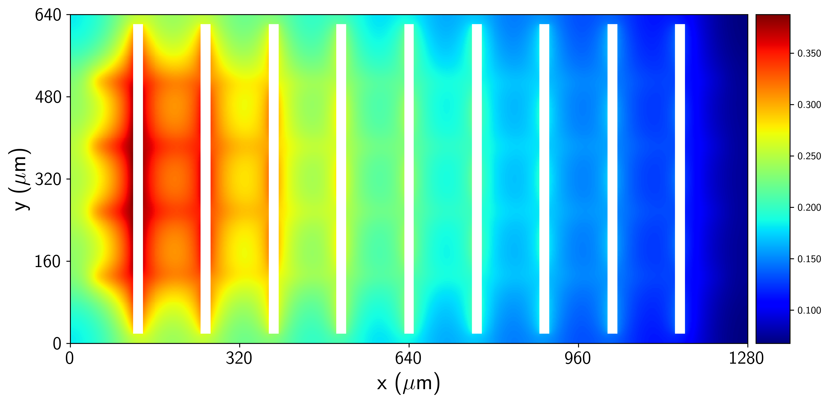
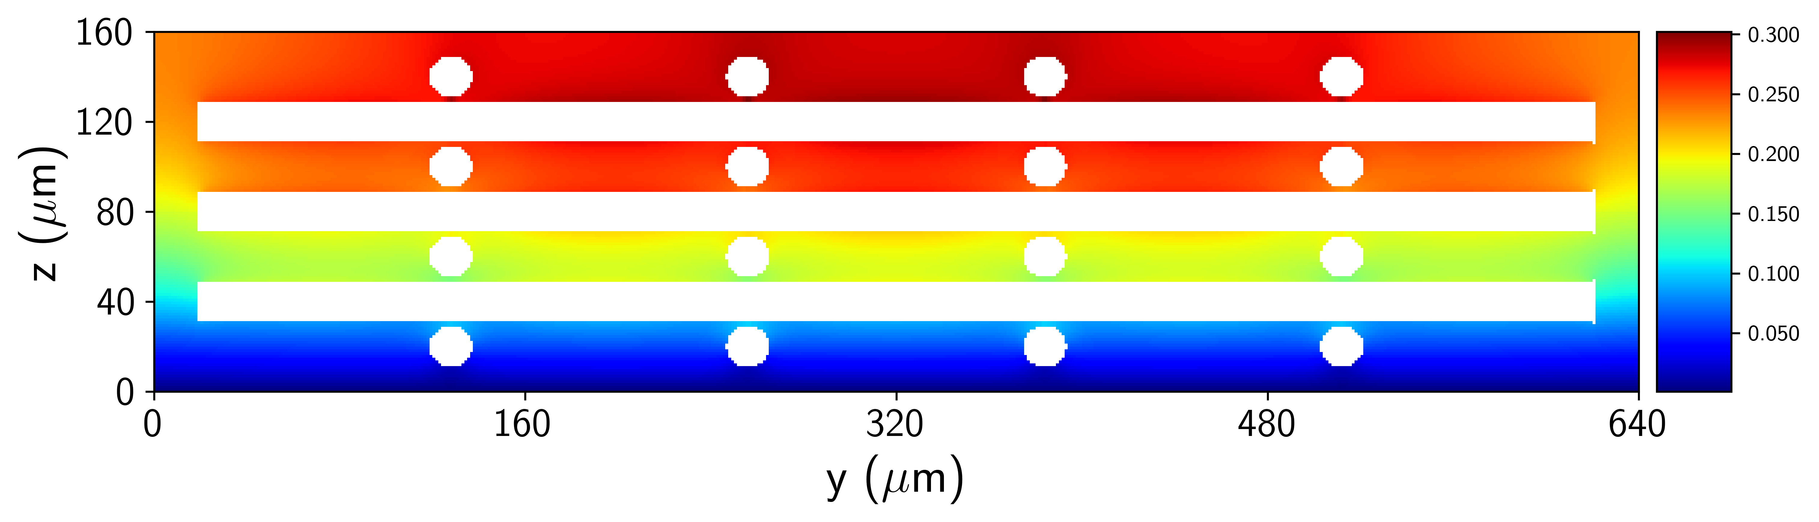
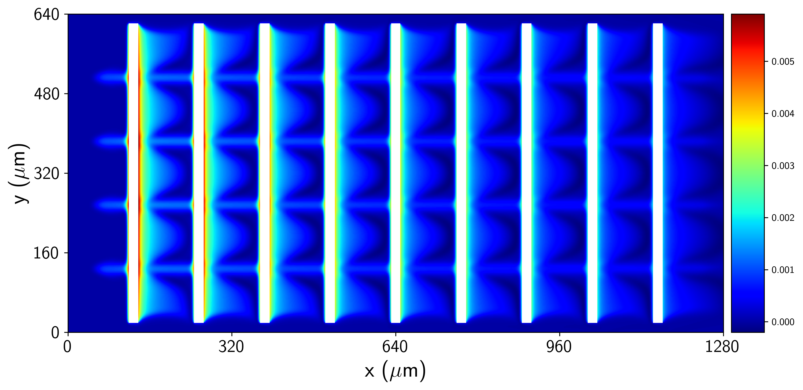
Electromigration is Negligible – Model Refinement
State of Charge
Electrolyte Potential ϕ_{L}
a
b
SOC Difference: Special vs. BV
c
c
d
Simulation of a logpile geometry; cross section at mid-plane
(a) state of charge; reduced species builds up and spreads out due to diffusion as flow moves through electrode
(b-c) potential in electrolyte is negligible, max of 0.47 mV
(d) special model is very close to full BV, RMSE just 8.6E-4
23

Slide 24
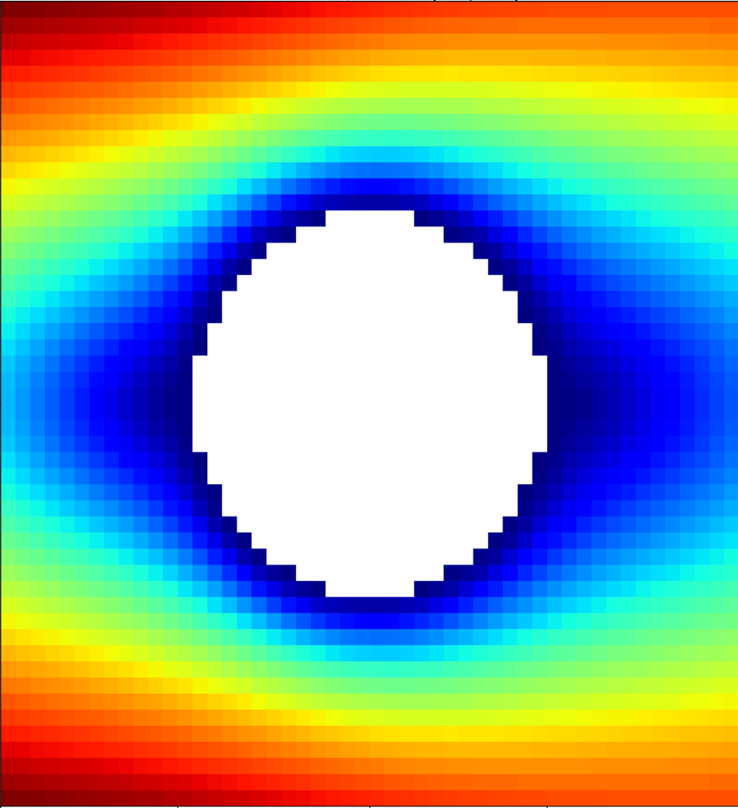
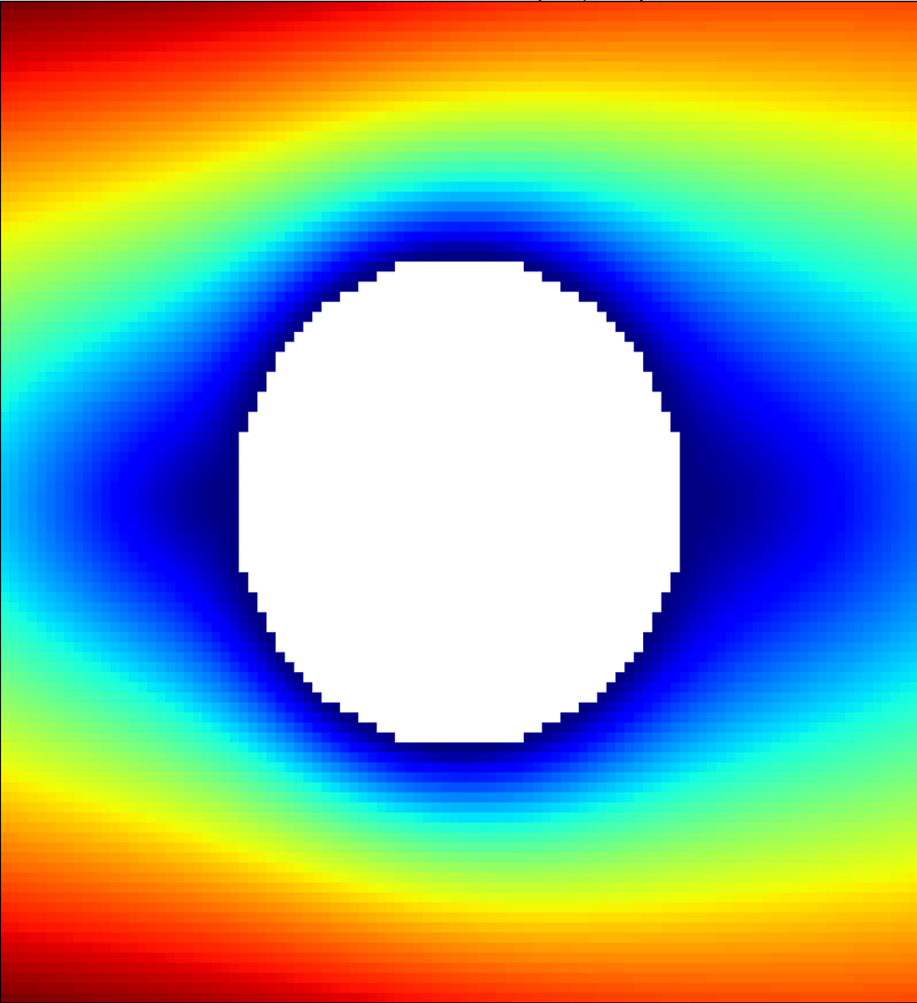

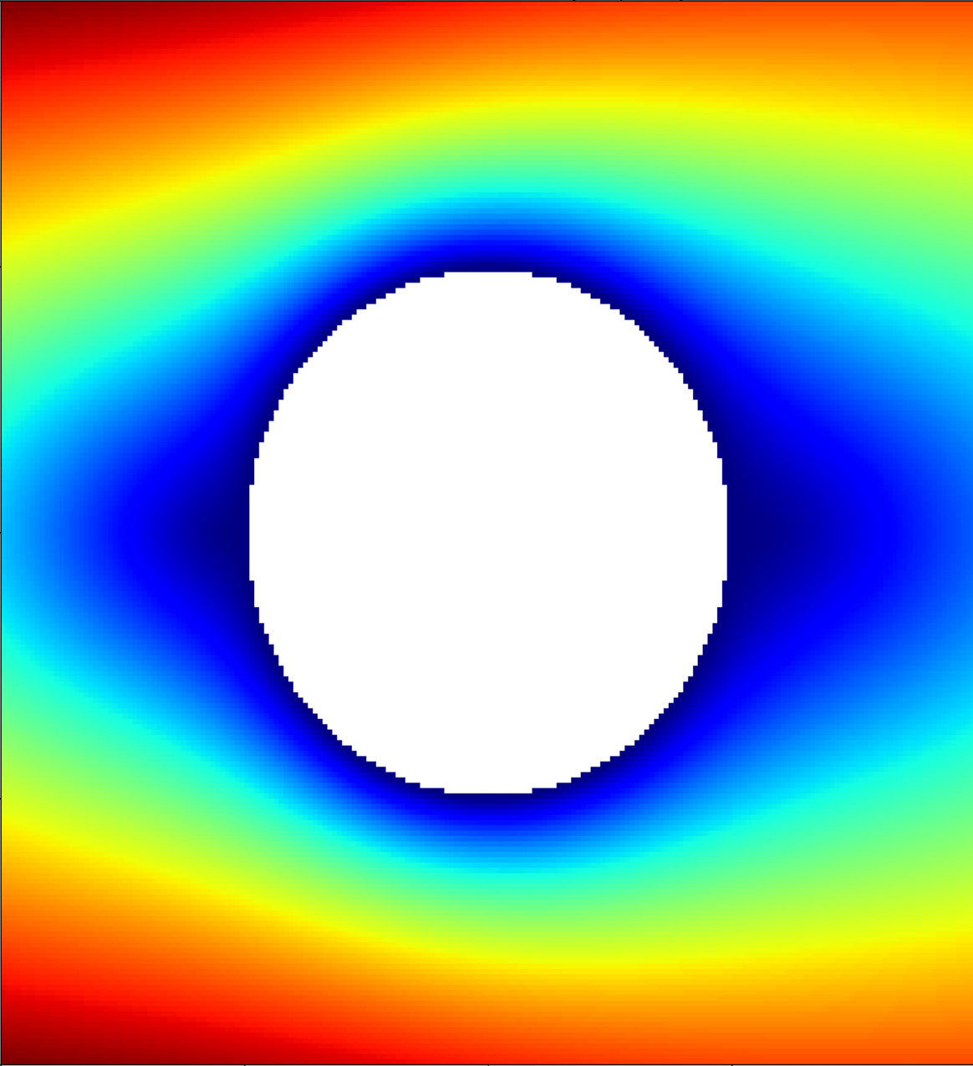
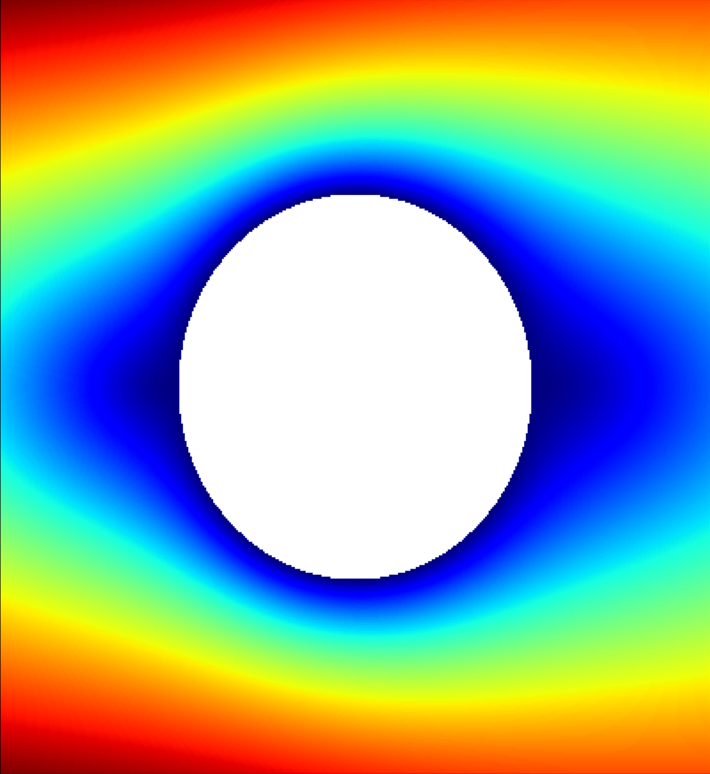
Iterative Upsampling: “Multigrid on Steroids”
Fluid simulation of a 100 μm diameter single wire in an open channel of 1.0 x 1.0 mm
Resolution doubles at each step
Each simulation is initialized with results of the coarser resolution
Convergence time improved from 41 hours to under one hour
2.5 mm/s
Box = 4.0 μm
Box = 2.0 μm
0.0 mm/s
M. S. Emanuel, Simulating Porous Electrodes in Redox Flow Batteries. APS DFD talk, 21Nov2023.
Box = 1.0 μm
Box = 0.5 μm
24
Notes:
Fluid enters the inlet at 2.8 mm/sec
Simulation has fully converged at the finest resolution

Slide 25
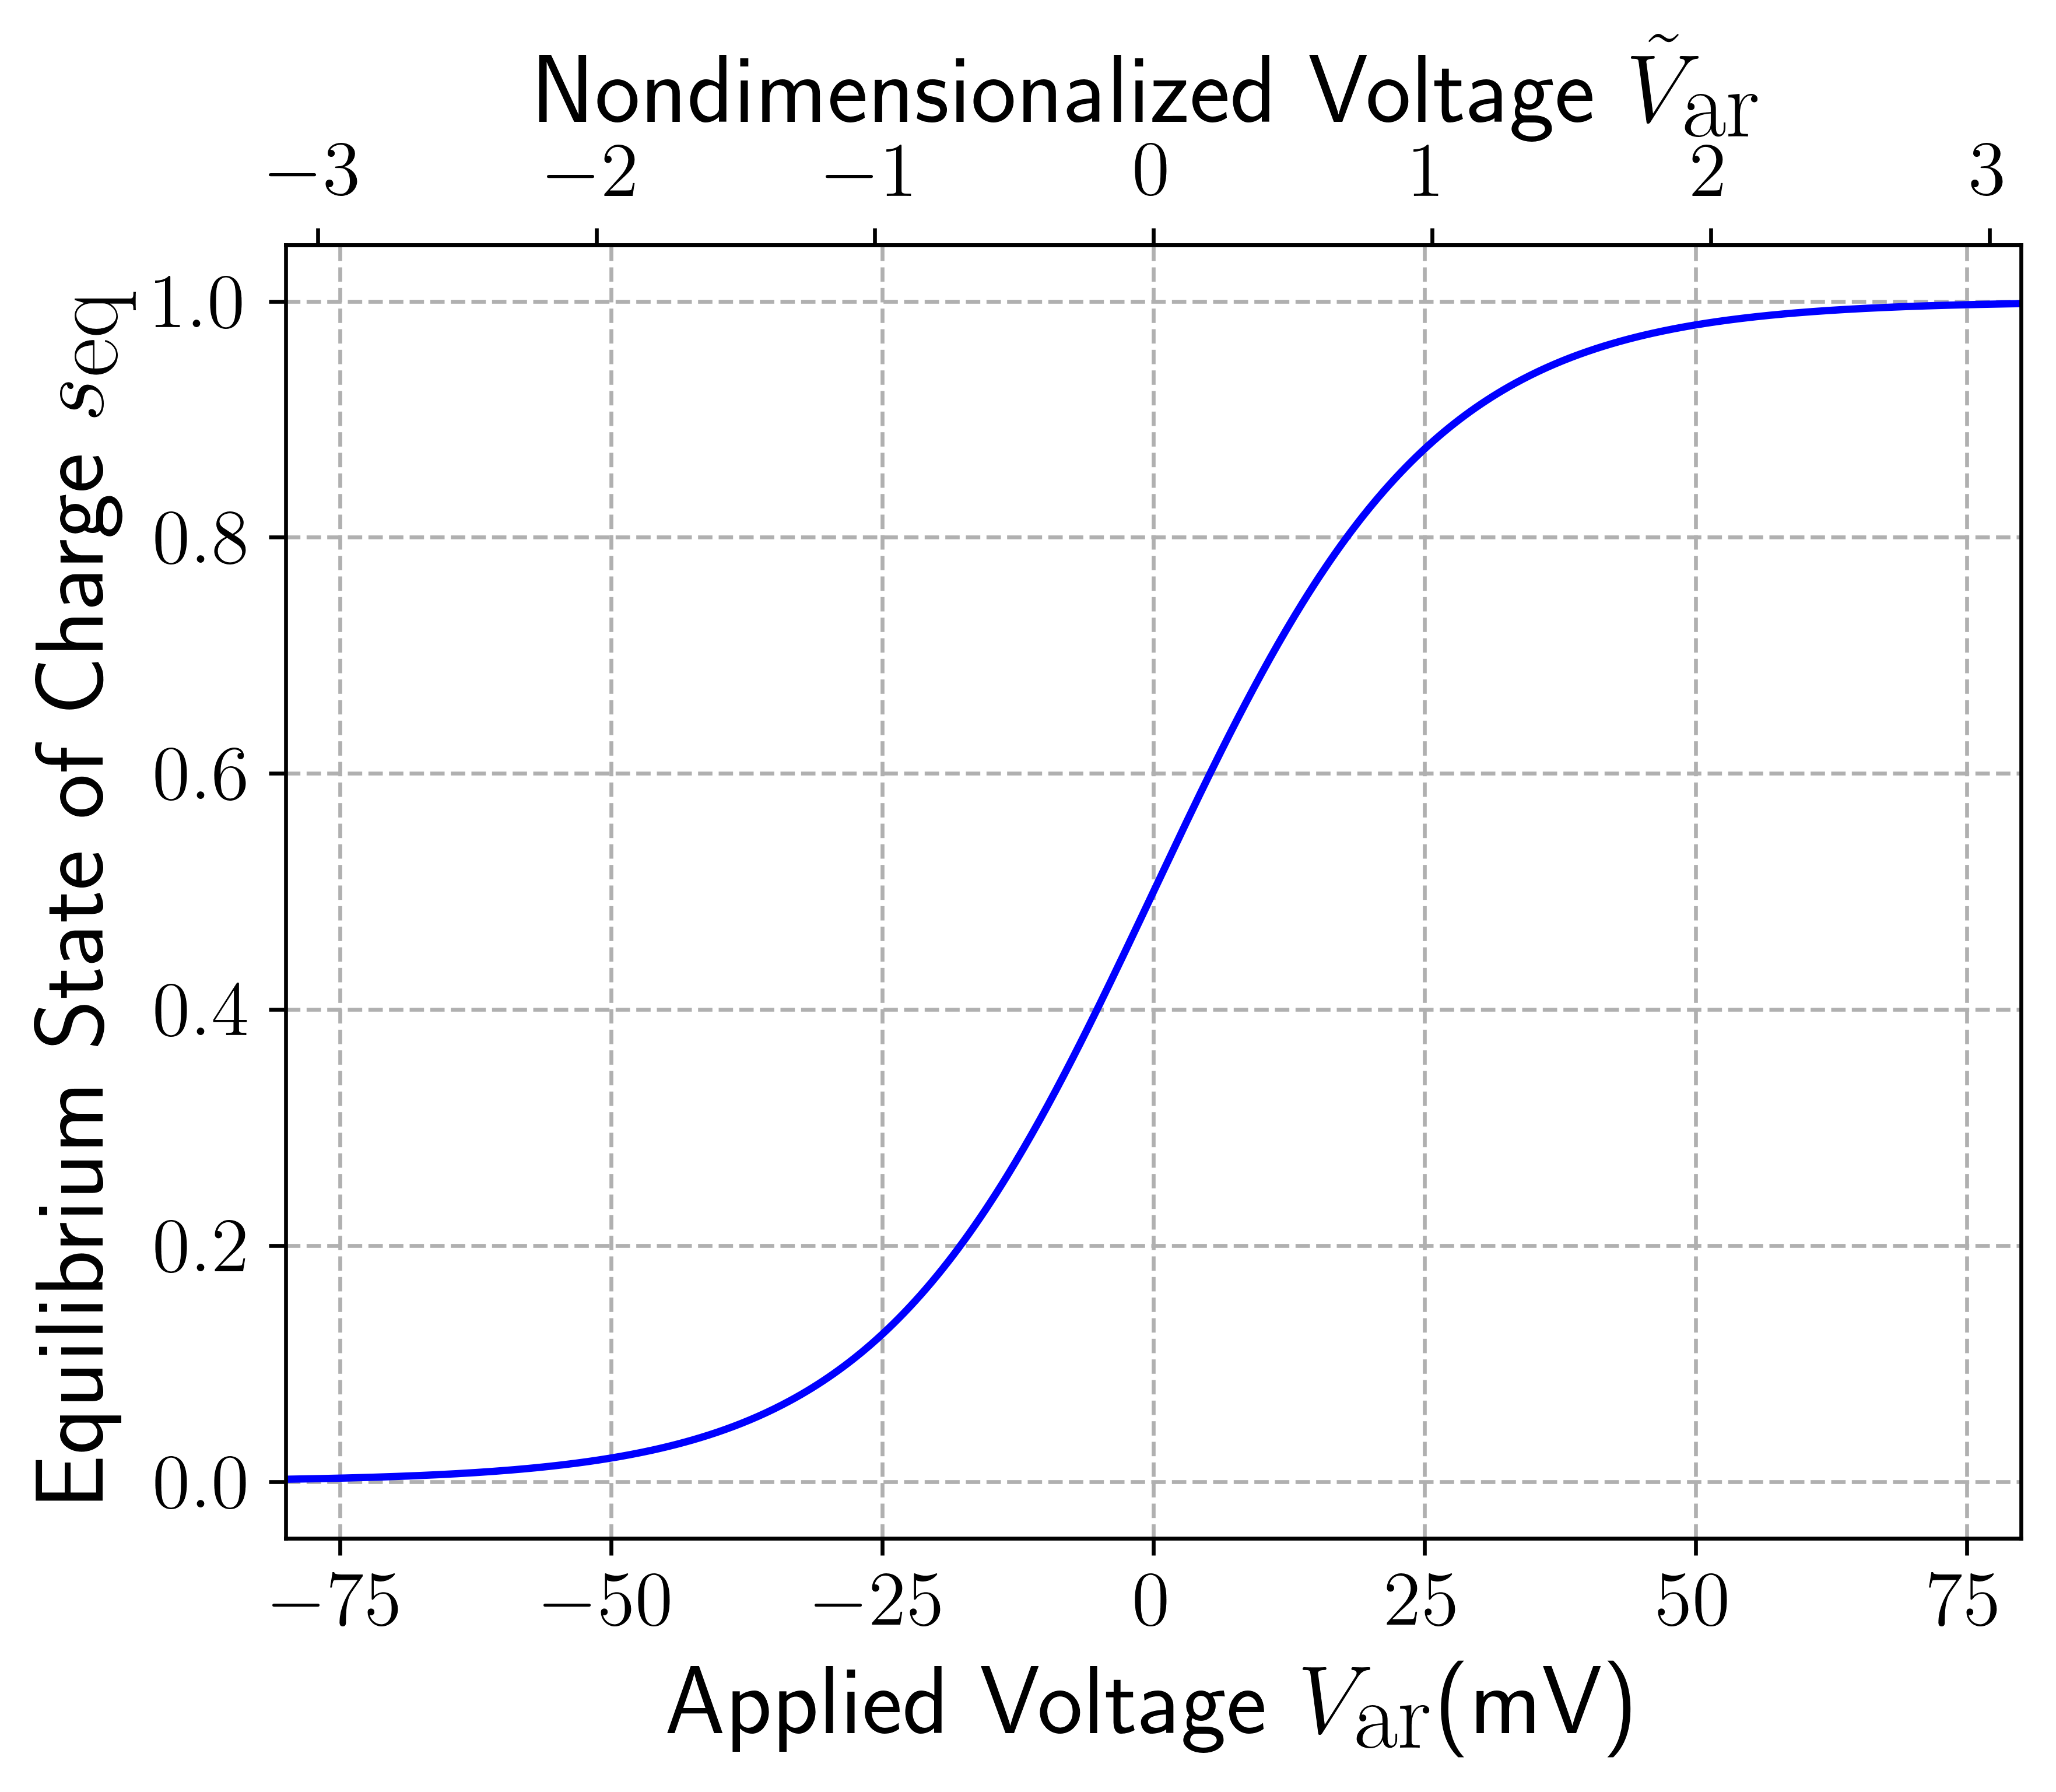
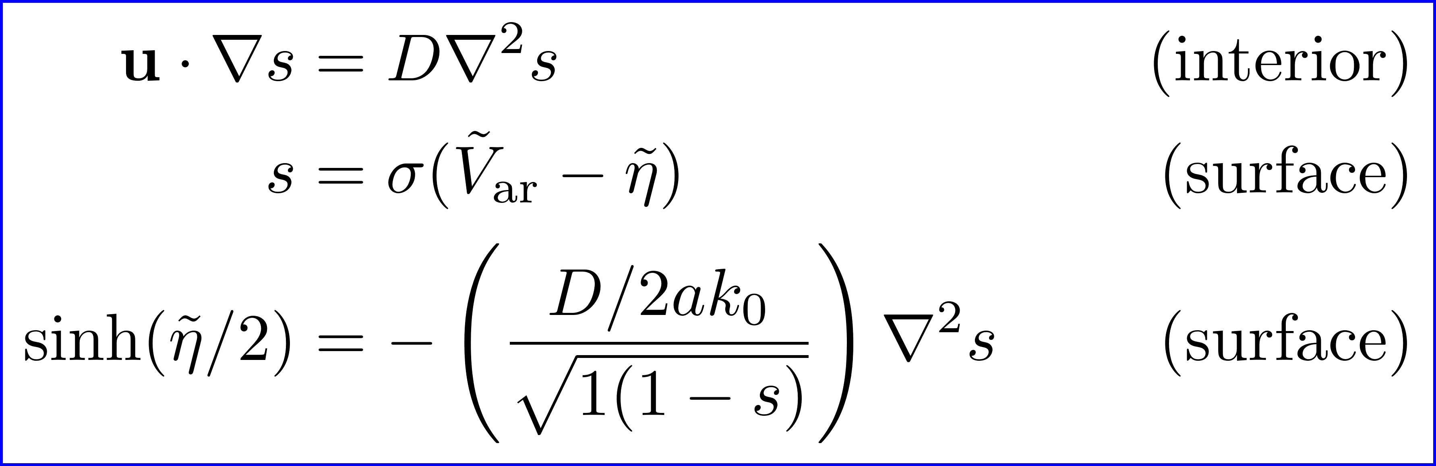
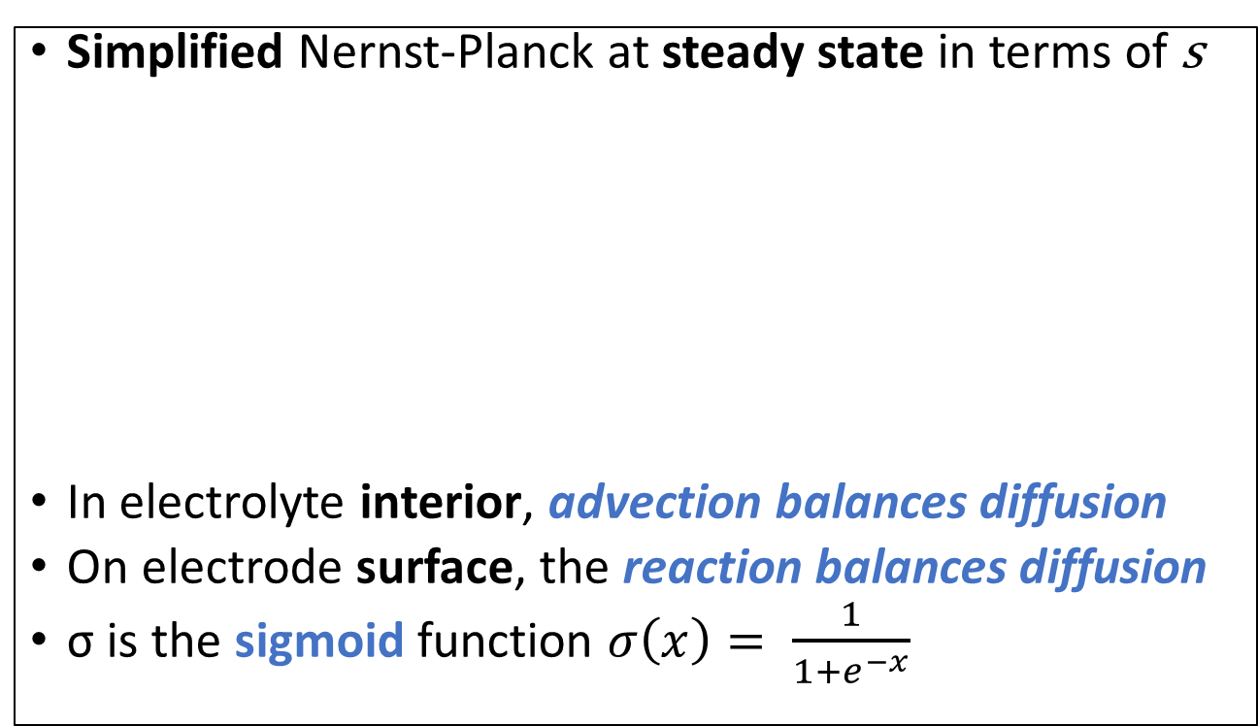
Steady State PDE in Terms of State of Charge s
Simplified Nernst-Planck at steady state in terms of s
In electrolyte interior, advection balances diffusion
On electrode surface, the reaction balances diffusion
σ is the sigmoid function $σ\left(x\right)= \frac{1}{1+e^{−x}}$
$\tilde{V}\text{ar}=\frac{ne V\text{ar}}{VT}$ and $\tilde{η}=\frac{ne η}{VT}$ are nondimensionalized voltage & overpotential
25
Notes:
Total electroactive concentration $c0$is a constant under modest assumptions; all concentrations known from the state of charge s
Analogy – merging onto a highway. How fast traffic moving on the pike = advection. Merging in = diffusion.

Slide 26
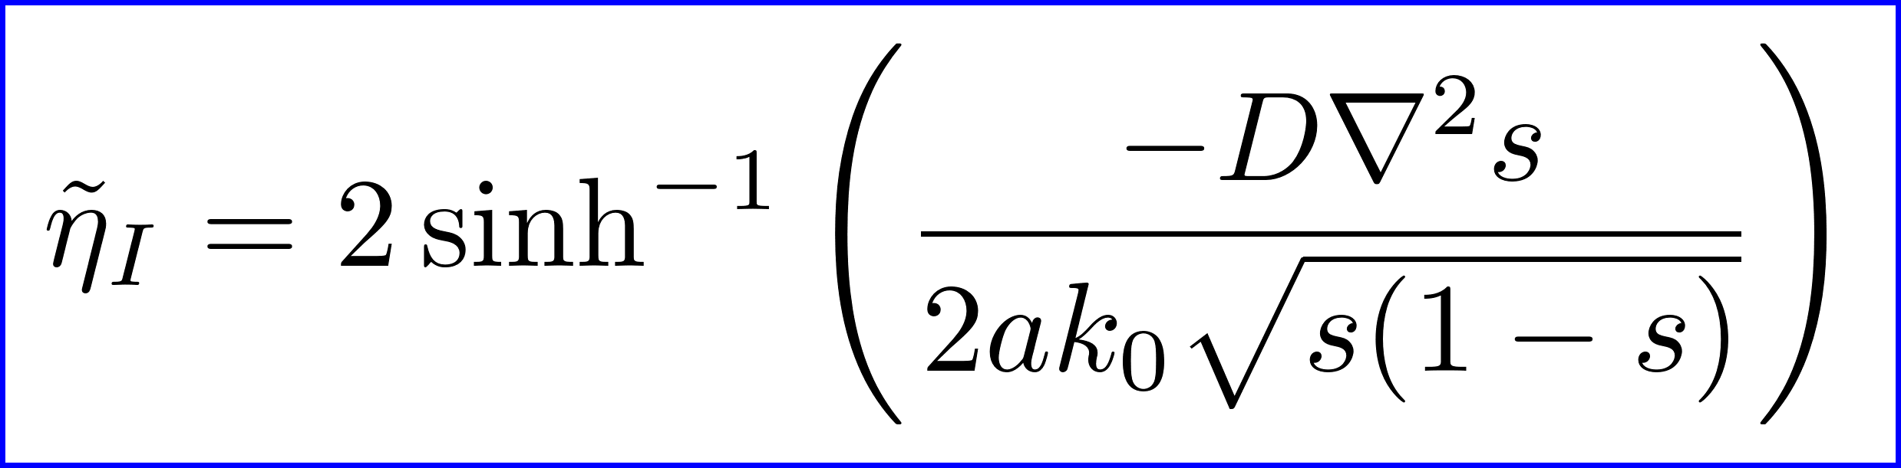
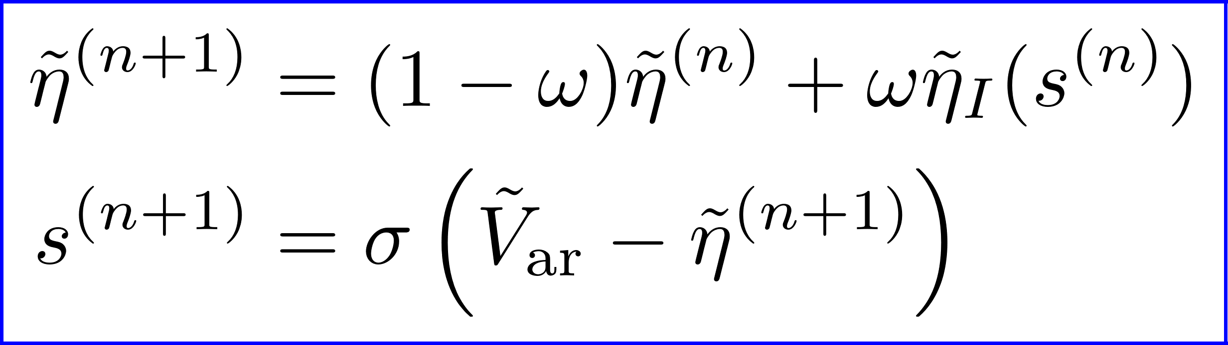
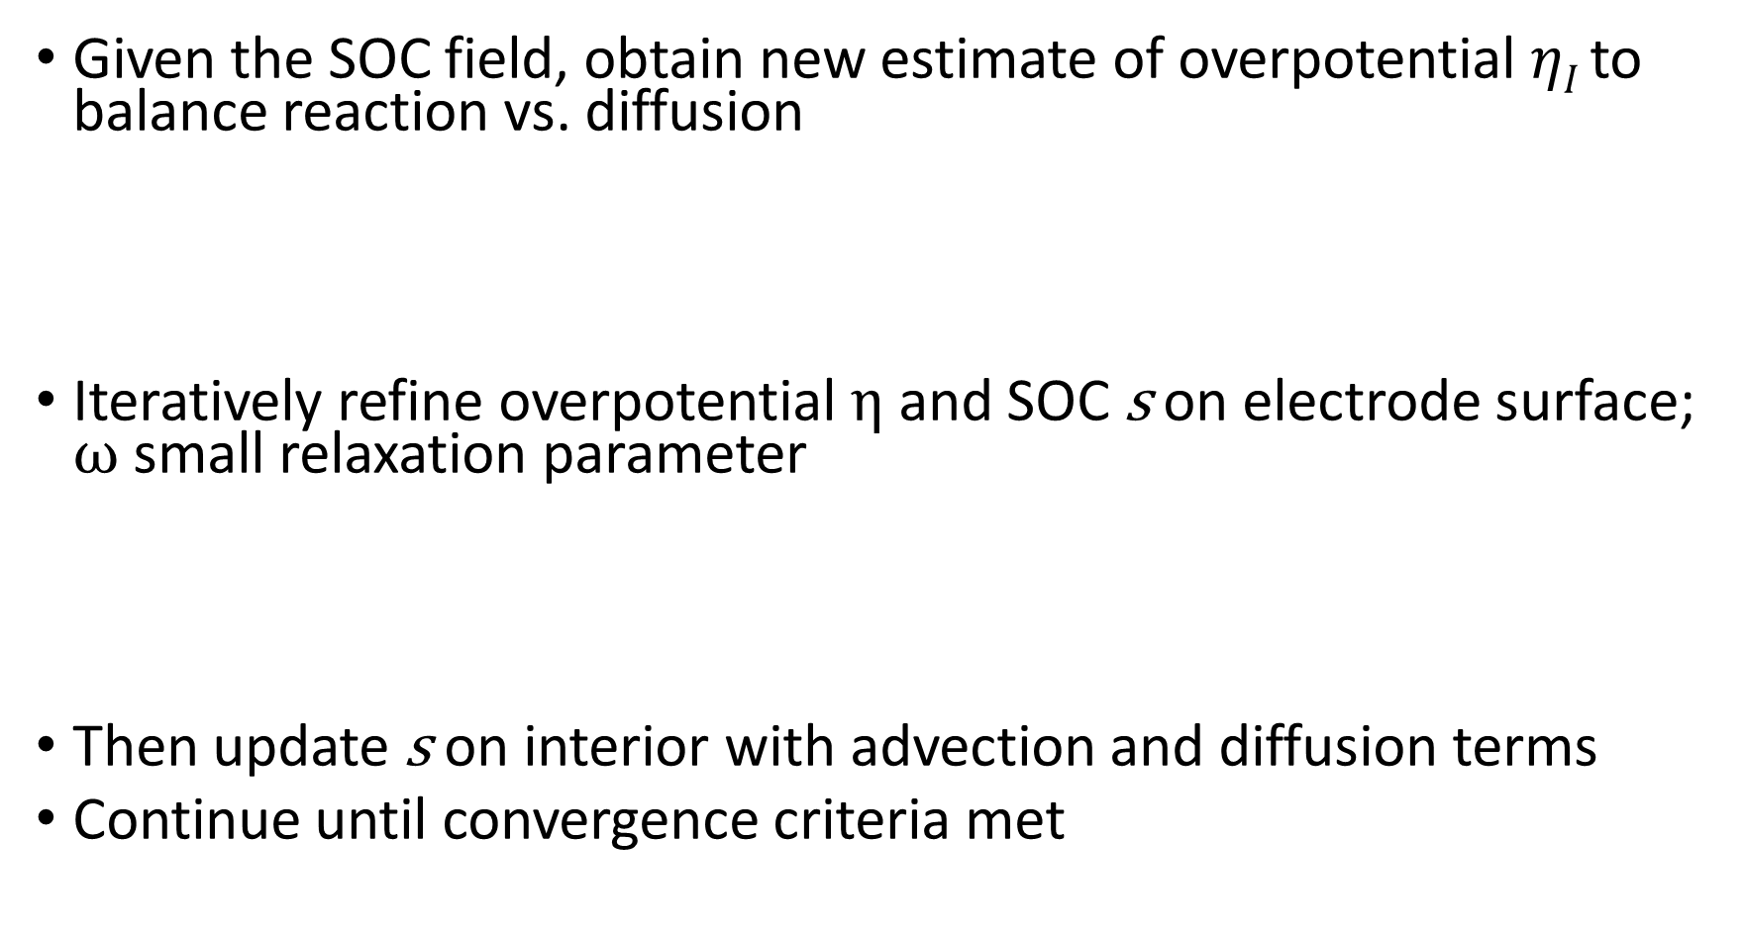
Nernst Model
Given the SOC field, obtain new estimate of overpotential $ηI$ to balance reaction vs. diffusion
Iteratively refine overpotential η and SOC s on electrode surface; ω small relaxation parameter
Then update s on interior with advection and diffusion terms
Continue until convergence criteria met
26

Slide 27
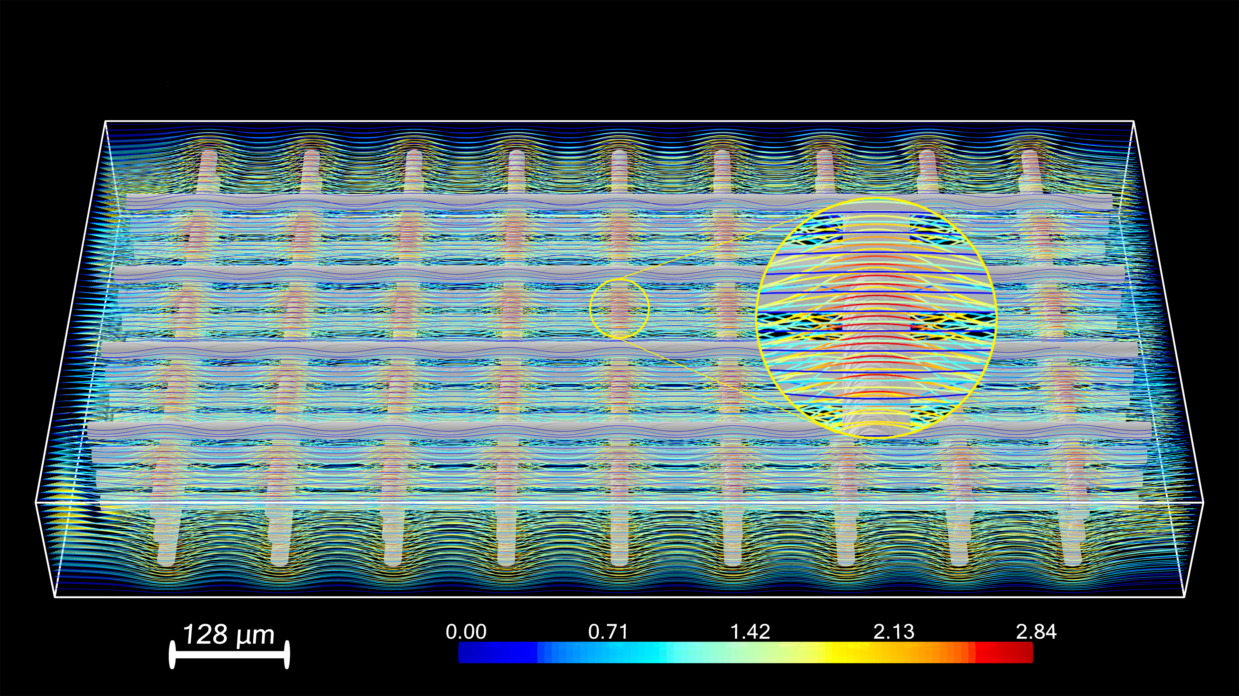
Results: Fluid Flow Streamlines
Flow Speed (cm/s)
27

Slide 28
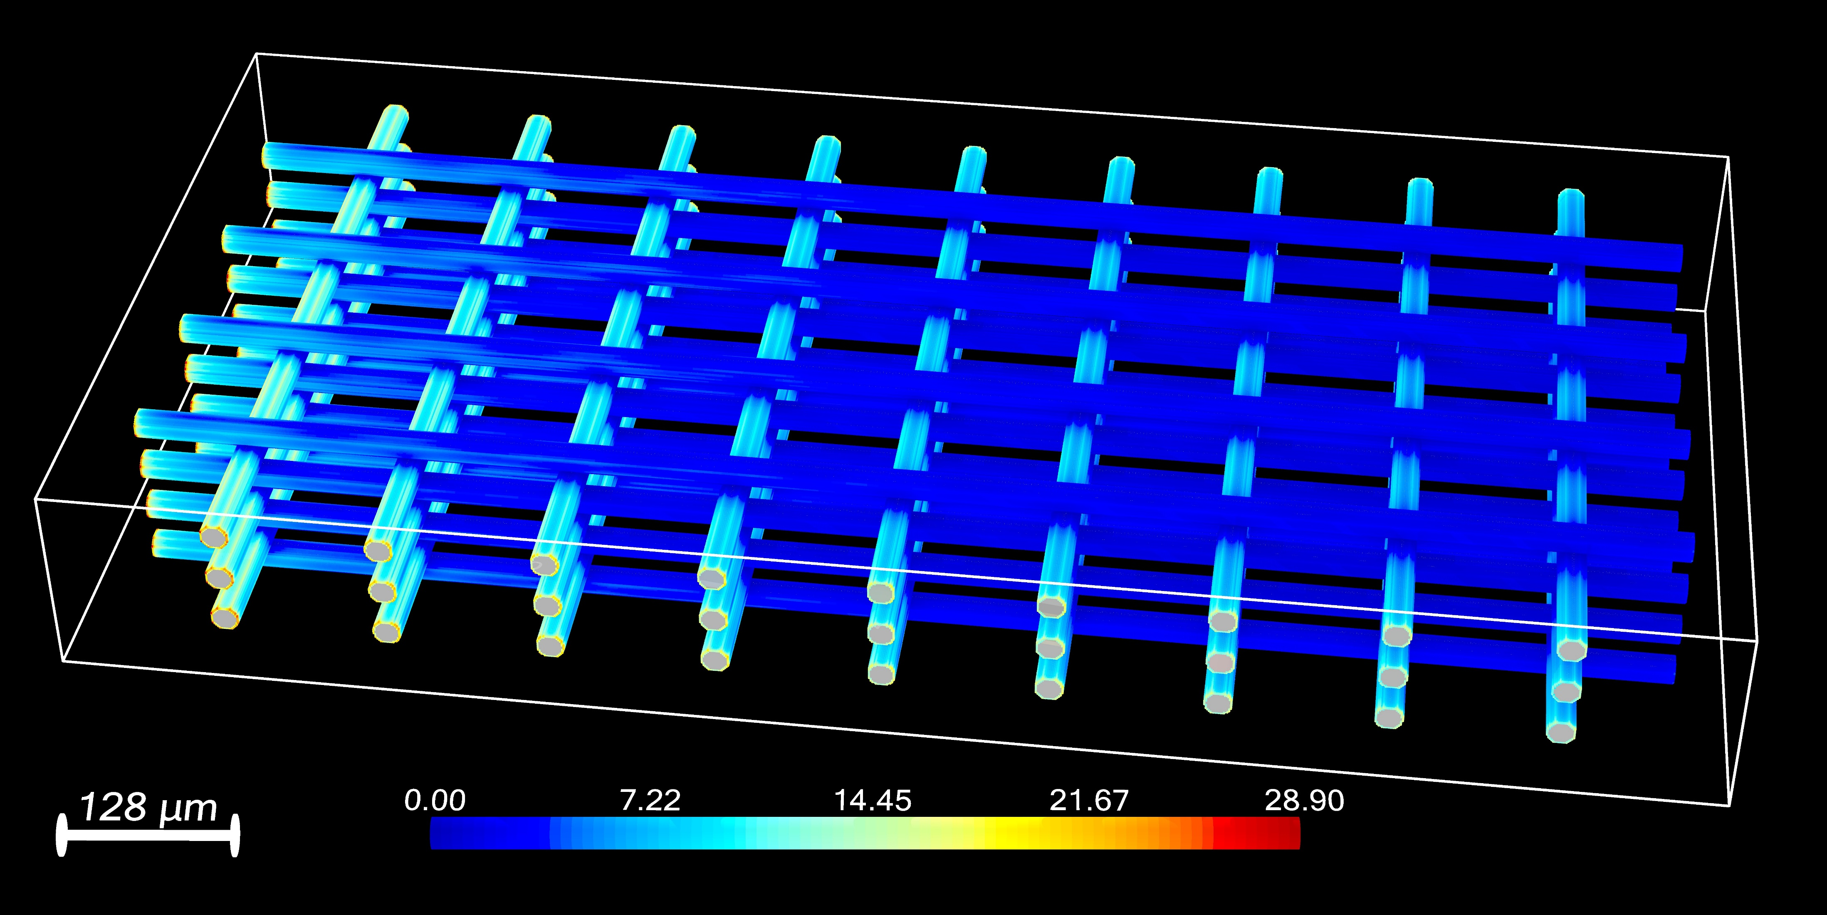
Results: Overpotential on Electrode
Overpotential (mV)
28

Slide 29
2. Calculating SOC from Images of a Commercial Porous Electrode
2 SOC Map

Slide 30

QEFSM Experimental Setup
A. M. Graf, T. Cochard, K. Amini, M.S. Emanuel, S. M. Rubenstein, M. J. Aziz, Quantitative Local State of Charge Mapping by Operando Electrochemical Fluorescence Microscopy in Porous Electrodes. Energy Advances.
Microfluidic flow cell compatible with electrochemistry and confocal microscopy. A) Exploded view of the individual components with labeled coordinates. B) Images of assembled cell from above (top) and below (bottom). Working electrode visible in bottom image. C) Widefield optical microscopy image of commercial AvCarb MGL 190 electrode.
30

Slide 31

Fluorescence Difference of AQDS Redox Pair
Emission spectra of 40 mM AQDS solutions vs. wavelength λ at different SOCs obtained from excitation wavelength λ_{ex} = 405 nm. Shaded rectangle—accepted range of green band-pass filter.
Raw intensities integrated over shaded region of (B) vs. SOC. Solid lines: theoretical concentration fraction of each species from dimer model.
Quantitative Local State of Charge Mapping by Operando Electrochemical Fluorescence Microscopy in Porous Electrodes.
31
Notes:
Reduction scheme of AQDS to H₂AQDS via PCET (top). Dimer formation (bottom).
Note significant amount of dimer at 50% SOC leading to a decidedly nonlinear response of brightness vs. SOC.

Slide 32

Modeling Brightness vs. Concentrations
28 operating images (4 concentrations x 7 voltages)
One bright calibration image at high, uniform SOC
Challenges: shadows, misalignment, nonlinear response
Light production model $Pri= α\left[\text{AQ}\right]ri+ β\left[\text{H}\text{2}\text{AQ}\right]ri+ γ\left[\text{Q}\text{H}\right]ri+ δ$
Optical model $Iri=Fi⋅Pri$
AQ, H₂AQ and QH are oxidized, reduced and dimer
Indices r for reaction condition, i for pixel
32

Slide 33

Calculating SOC from Brightness
Optical factors: from bright image, $Fi=\frac{Bi}{\overline{B}}$
Brightness coefficients: C = [α; β; γ; δ]
Weighted Concentration: $Xri= \left[\text{AQ},\text{H}\text{2}\text{AQ},\text{QH}, 1\right]ri⋅Fi$
Regress $\overline{I}=\overline{X}C$ (by mean on 28 runs)
Iterate brightness: regress $I=XC$ (by pixel)
Iterate factors: regress $Ir=\operatorname{Pr}{Fi}$ (by run)
I
X
C
=
N x 1
N x 4
4 x 1
Regression for C
I
P
F
=
28 x 1
28 x 1
1 x 1
Regression for F_{i}
33
Notes:
Solve all concentrations from y = [H₂AQ] / C_{T}
Dimensionless dimer coefficient, R = K_{dim} C_{T}
Solution: $x= \frac{(1−y)}{(1+2Ry)}$, $z= \frac{Ry(1−y)}{(1+2Ry)}$

Slide 34

QEFSM Results—Minimal Visual Artifacts
Local SOC from image data
A) Steady state SOC maps under varying conditions. B) Histograms of SOC distribution over valid pixels for each image.
Note significant departures from linear gradient predicted by mean-field theory.
Quantitative Local State of Charge Mapping by Operando Electrochemical Fluorescence Microscopy in Porous Electrodes.
34
Notes:
Applied overpotential increases left to right (50, 100, 175 mV). Total AQ concentration increases top to bottom (10, 20, 30, 40).
White pixels are fibers / impurities.

Slide 35
3. Simulating an Acid-Base Generator
3 ABG

Slide 36


pH Swing Mechanism for Carbon Capture
M — generic metal ion with +1 charge, e.g. sodium
A — conjugate base a generic acid with −1 charge, e.g. acetate (CH₃COO⁻)
Basic solution absorbs carbon dioxide to form carbonate and bicarbonate
Carbon dioxide is released when this solution is later acidified
36
Notes:
The ocean is mildly alkaline and is a huge CO2 sink.

Slide 37


Acid-Base Generator Cell Structure
D. Xi, Y. Zheng, M. S. Emanuel, Z. Panlin, M. J. Aziz, Electrochemical Acid-Base Generators for Decoupled Carbon Management. Energy & Environmental Science.
37

Slide 38



ABG Schematic & Simulation Approach
Flow Field
Unfurling serpentine flow path to x-axis
Schematic; x-axis is flow direction, y-axis small space between anode and cathode
38

Slide 39


Explicit Time Steps for ABG Simulation
Plane Poiseuille flow (analytical solution)
Nernst-Planck equation for mass transport
Membrane boundary condition: electromigration replaces H⁺ with Na⁺
Uniform electric field from anode to cathode, E₀ = V_{app} / L_{y}
Explicit step—advection, diffusion, electromigration operators
Electroneutrality imposed; r = ρ⁺ / ρ⁻, f = $\sqrt{r}$, concentrations adjusted by r
Chemical equilibria solved—water and acetic acid dissociation
39
Notes:
Steady state obtained by iterating until convergence

Slide 40



Acid-Base Generator Simulation Results
pH
Simulation validates Dawei’s engineering design
High H⁺ concentration at top would indicate crossover…
There is negligible crossover attributable to mass transport as described by Nernst-Planck
Experimental findings of low crossover; hypothesis – due to membrane effects
Tractable with appropriate modeling assumptions
Difficult to get this level of intuition from experiments
NaA flows to right
[H⁺] (mM)
Electric Field
Negligible H⁺
H⁺
H⁺
[Na⁺] (mM)
Electric Field
Na⁺
Electrochemical Acid-Base Generators for Decoupled Carbon Management
40
Notes:
When H+ crosses over, H+ mixes with OH- to make water and heat. Bad!
Could not be readily simulated in COMSOL. Comparable works in literature lack simulations of this kind
.

Slide 41
4. Thermodynamic Analysis of a Quinone Carbon Capture System
4 QCC

Slide 42




Thermodynamic System of Equations (9)
Kiana’s Problem:
Chemical equilibria (7)
Electroneutrality
Quinone conservation
Problem: optimization in scipy doesn’t work!
42

Slide 43

Strategy for Optimization Problems
Eliminate variables
Nondimensionalize physical quantities
Rescale variables to mean near zero, variance near one
Map constrained variables to the real line:
E.g. if x > 0, use ln(x)
E.g. if x in (0, 1), use $logit\left(x\right)=ln⁡\left(\frac{x}{1−x}\right)$
Use 2-norm composite error function, e.g. $ε= \sqrt{ε12+ ε22}$
Use a neutral initial guess
43

Slide 44




Eliminating Variables
Operating conditions: $C_{T}, p_{CO_{2}}$
Inorganic concentrations: M⁺, H⁺, OH⁻, CO₂ (aq), HCO₃⁻, CO₃²⁻
Organic concentrations: AQH₂, AQH⁻, AQH²⁻, AQH(CO₂)₂
Solve inorganic concentrations in terms of [H⁺]:
Solve organic concentrations in terms of [AQH₂]:
Left with two variables, [H⁺] and [AQH₂]
Manipulate state variables to minimize composite error
44

Slide 45




Transforming Variables & Calling Optimizer
Two state variables, [H⁺] and [AQH₂]
Apply transformations to state variables
Define errors—electroneutrality, quinone conservation, and composite
Optimizer: minimize composite error by adjusting x and y
45

Slide 46

Results: Three Behavioral Regimes
Concentrations of HCO₃⁻, CO₃²⁻, CO₂ (aq) and AQ(CO₂)₂²⁻ at different K_{AQ-adduct} values. Gray region: pH swing dominates. Blue region: nucleophilicity swing dominates. Red region: both mechanisms in play.
Understanding dominant behavior leads to better molecular engineering strategies.
In Situ Techniques for Aqueous Quinone-Mediated Electrochemical Carbon Capture and Release.
46
Notes:
(a-c): Equilibrium concentrations by solving equations.
Total concentration of 0.2M AQ with K₄ = 1.1E−6, K₅ = 4.1E−10, K_{w} = 1.0E−14.

Slide 47
Conclusions & Future Research Directions

Slide 48
Scientific Conclusions
Modeling steady state easier than integrating dynamics
Any mass transport system can be modeled at steady state by switching from flux to boundary value condition
Useful to have a series of related models on same back-end with increasing levels of fidelity
Porous electrodes in flow batteries are typically run in the Stokes flow regime with negligible electromigration
A porous electrode geometry can be evaluated with a single flow simulation plus a handful of reaction simulations
We can do computational design of electrodes!
48

Slide 49
Comments on Scientific Computing
We should broaden our ambitions in the exascale age of massive scientific supercomputers
Direct numerical simulations of PDEs are now within reach
Explicit methods are often underappreciated
Applied mathematicians should collaborate across disciplines more…
But institutional support and incentives are lacking
Data analysis is now a specialty and should be treated as such
49
Notes:
Yoda: “You must unlearn what you have learned.”

Slide 50

Future Research Directions
Digital twin for active learning and surrogate ML models
Darcy mosaic model: 3D grid of box-shaped tiles
Coupled hydraulically by Darcy flow
Coupled electrochemically by SOC values on shared faces
Mass transfer coefficient k_{m} as emergent vs. phenomenological
50

Slide 51
Acknowledgments

Slide 52



Advisors: Chris Rycroft & Mike Aziz
Advisor:
Chris H. Rycroft
Co-Advisor:
Michael J. Aziz
U.S. Department of Energy Office of Basic Energy Sciences Grant DE-SC0020170
52

Slide 53




Rycroft Group
53

Slide 54









Aziz Group
54

Slide 55



Convexity Colleagues
55

Slide 56





Old Friends
56

Slide 57


Gibson Family
57

Slide 58


Emanuel Family (OG)
58

Slide 59



My Family
59

Slide 60
Afterword: Responding to a Time of Crisis in America

Slide 61
Defending Harvard Against Tyranny
Harvard is under attack by our own government
Trump wants to control who we hire, what we teach, and even what we think
As a Jewish American student, I know antisemitism is a real problem, but I say to Trump and his thought police: You do not speak for me when you attack Harvard. We are confronting our problems together, as a community of scholars, students and researchers. Stay out of it.
To the rest of you I say: Please stand with me to defend Harvard against this unjustified and un-American attack!
61

Slide 62
Sustaining Science at Harvard and Beyond
Harvard may ultimately prevail in litigation, but not for years
Even the Harvard endowment cannot fund our research
We won’t be able to flip a switch and “turn science back on”
A handful of influential philanthropists could sustain science at Harvard until we emerge from this crisis
I have one foot in each of the worlds of finance and science
Even a modest gift could have a transformational impact
If you or someone you know can help, please contact me! (michael.s.emanuel@gmail.com)
62

Slide 63
Appendix

Slide 64
Teasers to Read Dissertation
Dedication and acknowledgments
Epigraphs—textual, musical (!) and youthful
Details—conceptual, numerical and experimental
Foreword—personalized overview of my research
Introduction—larger scientific context of my work
Afterword—addressing the crisis in American science
64

Slide 65
Image URLs
https://www.eia.gov/todayinenergy/detail.php?id=56880
https://www.energy-storage.news/us-installed-grid-scale-battery-storage-capacity-reached-9gw-25gwh-in-record-breaking-2022/
https://www.npr.org/sections/the-picture-show/2025/01/13/g-s1-42407/see-california-wildfire-devastation-pictures-altadena-eaton-palisades
https://www.catf.us/resource/carbon-capture-storage-what-can-learn-from-project-track-record/
https://en.wikipedia.org/wiki/Quinone
65

